Slide 1
Yet Another Apps vs Web Presentation
Jon Marks
@McBoof

Slide 2
Prologue Hello, I’m Jon.

Slide 3
Spent half my life in Africa. And the other half up North.
1970-something
A long time ago

Slide 4
4 kids. Boy. Girl. Pugpig. Boy.
2008 - 2015
Recently

Slide 5
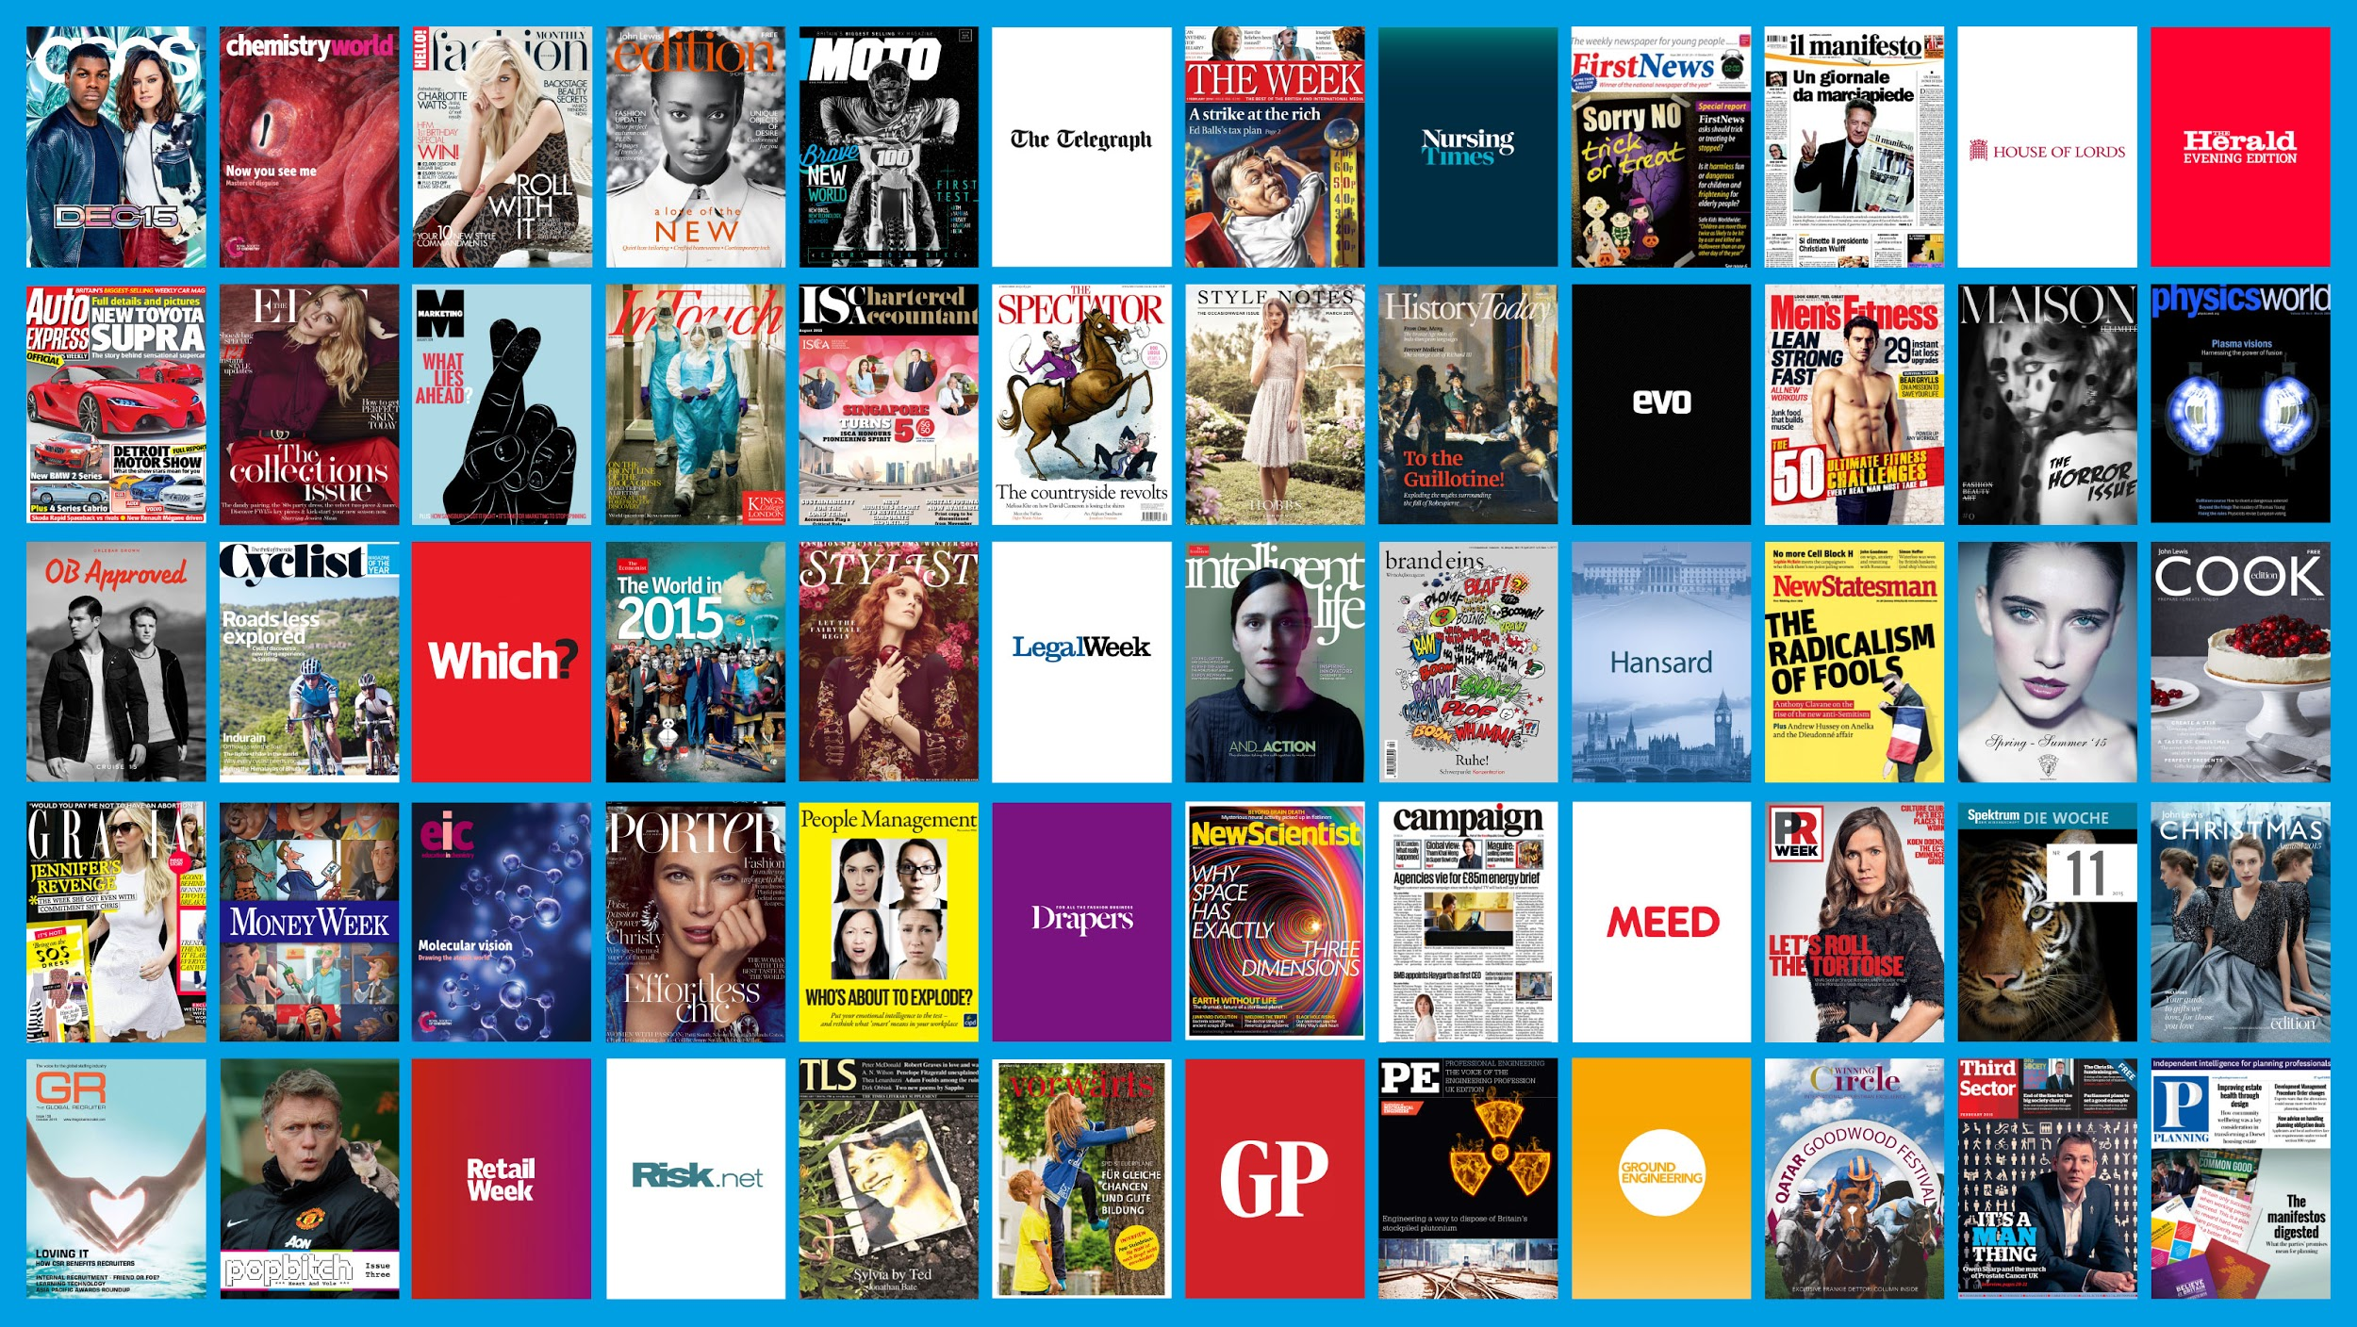
The best digital publishing platform on the planet
Notes:
Can we do an updated one with more of the new covers

Slide 6
Aging left wing, tree hugging, open standards obsessed hippy.

Slide 7
This is the year I used to confidently predict would be the death of the app.
2017
2 years in the future

Slide 8
But now I’m not so sure ….

Slide 9
Part I Things happen. Fast.
Notes:
Do standards always prevail, and how long does it take?

Slide 10
Research Program at DARPA starts talking about the Internet
1962
53 years ago
Notes:
The first recorded description of the social interactions that could be enabled through networking was a series of memos written by J.C.R. Licklider of MIT in August 1962 discussing his "Galactic Network" concept. He envisioned a globally interconnected set of computers through which everyone could quickly access data and programs from any site. In spirit, the concept was very much like the Internet of today. Licklider was the first head of the computer research program at DARPA,4 starting in October 1962. While at DARPA he convinced his successors at DARPA, Ivan Sutherland, Bob Taylor, and MIT researcher Lawrence G. Roberts, of the importance of this networking concept.

Slide 11
1962

Slide 12
20 Bond movies
5 Bond actors
44 years of progress
1962 - 2006
A lifetime

Slide 13
2006

Slide 14
You probably had a BlackBerry when you watched Casino Royale.

Slide 15
Symbian
Windows Mobile 6
RIM
Linux
2007
8 years ago

Slide 16
iPhone 1, iPhone OS 1
2007
8 years ago

Slide 17
2008

Slide 18
WHATWG published the First Public Working Draft of the HTML5 specification
2008
7 years ago

Slide 19
Android 1.0
2008
7 years ago

Slide 20
Android 1.5 (Cupcake)
2009
6 years ago

Slide 21
iTab iSlate iPad 1
2010
5 years ago

Slide 22
Windows Phone 7 (7% US)
2010
5 years ago

Slide 23
2012

Slide 24
New kids on the block:
Uber, AirBnB, SnapChat
2011- 2012
3 years ago
Notes:
http://graphics.wsj.com/billion-dollar-club/

Slide 25
Apple CarPlay
Android Auto
2014
1 year ago

Slide 26
Apple Watch
2015
6 months ago

Slide 27
iOS 9 (Force 3D Touch)
Android Marshmallow
2015
3 months ago

Slide 28
2012
2015

Slide 29
> 1.0 Billion iOS Devices
> 1.5 Billion Android Devices
2015
Now

Slide 30
Snapchat > $15 billion
AirBnB > $25 billion
Uber > $50 billion
2015
Now

Slide 31
Smartphone set to become the biggest consumer product in history
2016 - 2020
The short term
Notes:
Jargon and buzzwords in the industry are going down, not up. Consumerisation. Accessible to everyone. Easier to get internet than fresh water on this planet.

Slide 32
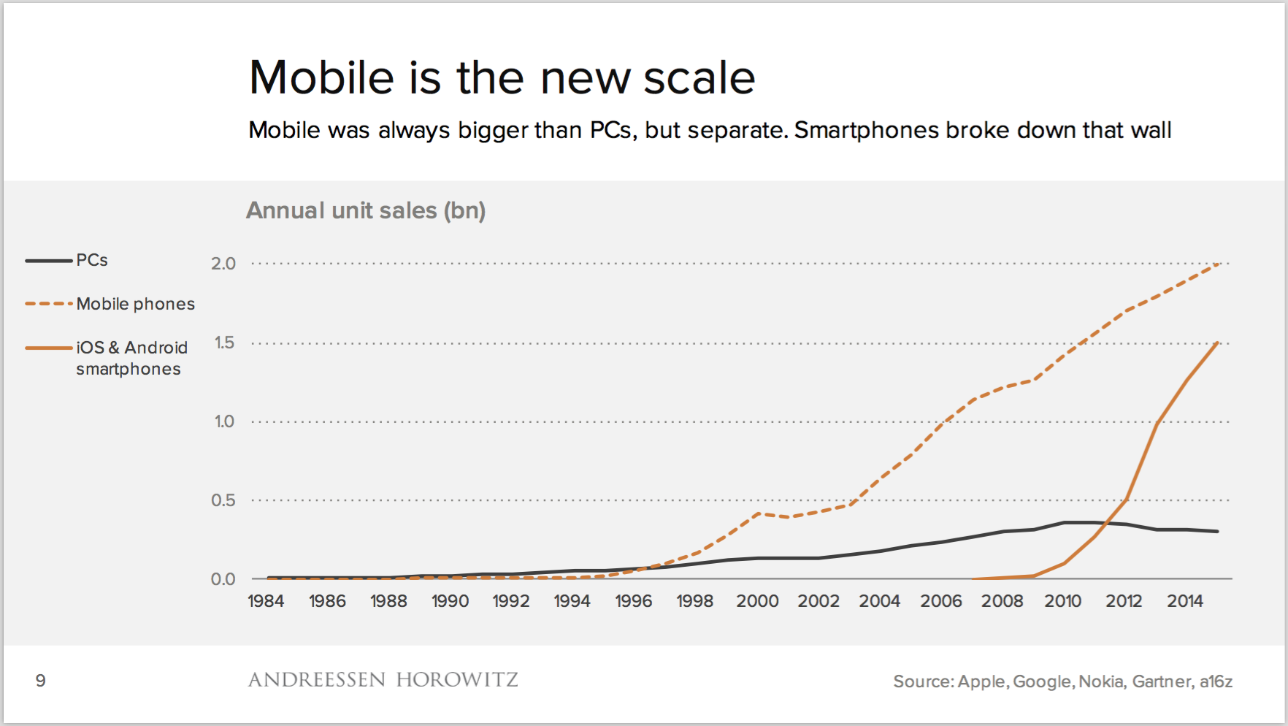
The obligatory chart

Slide 33
So compare apps and web with an eye to the future.

Slide 34
Part II Smartphones are smart.

Slide 35
“We need to provide a lean, fast, cut down experience for mobile users.”
2013
2 years ago

Slide 36
Um, no we don’t.

Slide 37
Your phone is more powerful than your previous laptop.
Today
Now

Slide 38
It is always with you, it knows where you are, and it pays for things.
Today
Now

Slide 39
The average person unlocks his or her smartphone 110 times each day.
Today
Now

Slide 40
Touch UIs are for everyone. Ages 2 - 120.
Today
Now
Notes:
Kids minecraft stry

Slide 41
For many people, keyboard are an optional extra.
Today
Now

Slide 42
So compare apps and web in a world where mobile and touch dominate mouse and keyboard.

Slide 43
Pause for Thought
Tweet on #gilbane

Slide 44
Part III The OS Wars are over.

Slide 45
BlackBerry Priv launches
November 2015
3 weeks ago
Notes:
http://arstechnica.com/gadgets/2015/11/blackberry-priv-review-android-fixes-the-os-but-the-hardware-cant-compete/

Slide 46
WTF!!?! They’re still around?
Notes:
http://arstechnica.com/gadgets/2015/11/blackberry-priv-review-android-fixes-the-os-but-the-hardware-cant-compete/

Slide 47
MS Project Astoria shelved
MS Project Islandwood lives?
November 2015
2 weeks ago

Slide 48
Windows 10 Mobile launches
December 2015
2 weeks time

Slide 49
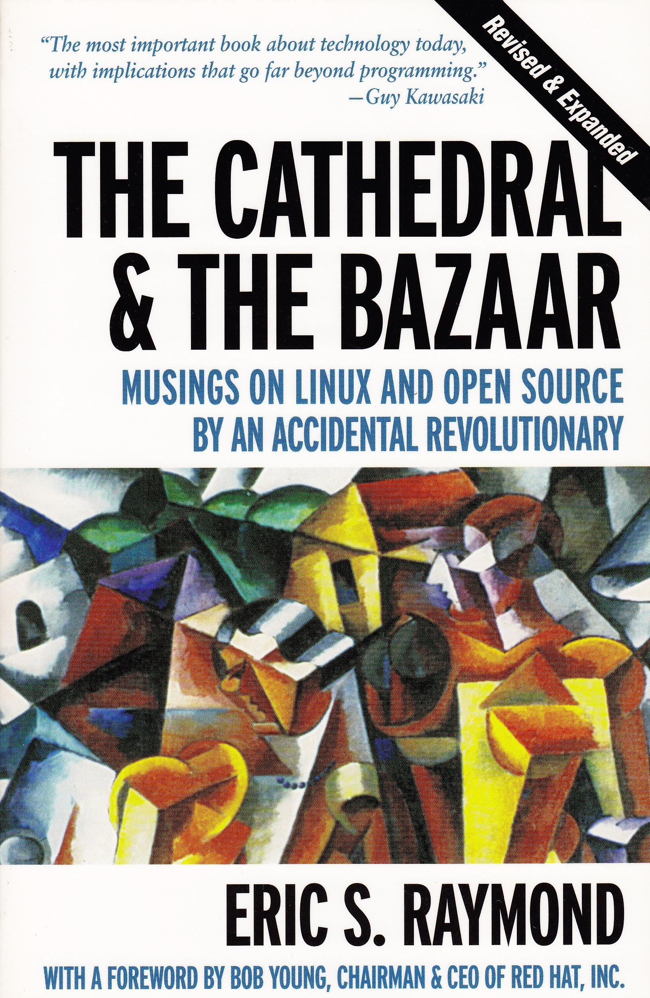
iOS and the two Androids
Very Different Philosophies
Notes:
iOS vs Android (wrong users)
Two Androids $50 and $500 very different

Slide 50
Operating systems are expanding into platforms
Today
Now

Slide 51
So compare apps and web in the context of two dominant yet different mobile platforms.

Slide 52
Part IV Actually, what’s an app?
Notes:
Do standards always prevail, and how long does it take?

Slide 53
Apps are written in native code. Mobile web in HTML/CSS/JavaScript.
Unless you’re using something like Cordova. Or web views.

Slide 54
Apps are distributed through stores or ecosystems. Mobile web is just there.
Unless you’re in the Firefox Marketplace or Chrome Web Store. Or an Enterprise App. Or China.

Slide 55
Mobile web is accessed via URLs. Apps aren’t?
And how long will we care about URLs for? Remember when browsers had a separate box for them?

Slide 56
Apps are silos. Mobile web is searchable and shareable.
Unless we can index the content of apps, and share deep links into them

Slide 57
Both Android Marshmallow and iOS 9 support app indexing and proper deep linking
2015
3 months ago

Slide 58
Apps are explicitly installed. Mobile web is just there.
Unless they’re streamed.

Slide 59
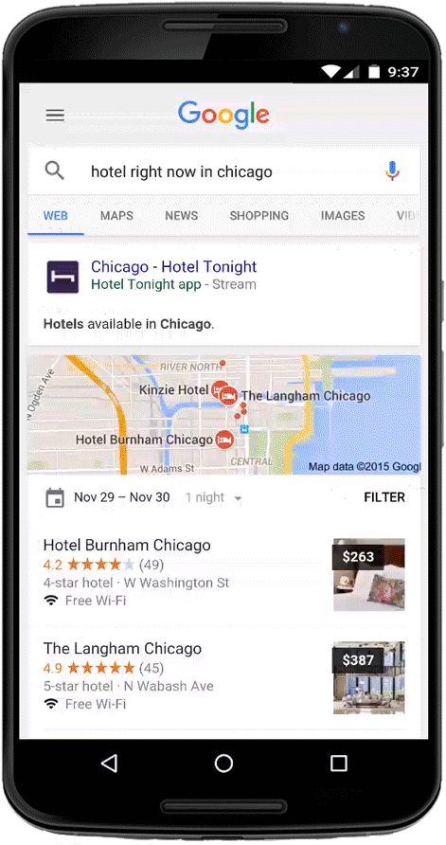
Google App Streaming. iOS will follow.
November 2015
3 weeks ago

Slide 60
Apps run in different runtimes - not a browser.
Notes:
** Platforms grow, tech platfrom becomes the digital arms for brands:
- Remember Tower Records
- Remember Universal and EMI
- Remember data centres
- Having your own website?

Slide 61
So compare apps and web but note that the consumer facing difference is blurring.

Slide 62
Part V What about standards?
Notes:
Do standards always prevail, and how long does it take?

Slide 63
W3C decided that they would not continue to evolve HTML. The future, they believed was XML.
1998
17 years ago

Slide 64
Sony stop selling Betamax tapes.
10 November 2015
3 weeks ago

Slide 65
Adobe says stop using Flash.
30 November 2015
2 days ago

Slide 66
The W3C is slow. Features talk, standards follow.

Slide 67
Google AMP. Apple News. Facebook Instant Articles.

Slide 68
And are the standards even the right standards for the future?
Notes:
WebView not in Apple Watch or TV

Slide 69
The Big Reverse?

Slide 70
Many devices won’t have browsers at all ...
Notes:
watches, cars, fridges, balloons, sensors, implants
Story about self driving cars and who writes the code

Slide 71
So compare apps and web
remembering that consumers don’t care about standards, and they decide what wins.

Slide 72
Part VI Head to Head.
Notes:
Do standards always prevail, and how long does it take?

Slide 73
It’s almost always more cost effective to build a mobile web site.

Slide 74
A Web App looks the same on all operating systems (because you only have to write one)

Slide 75
Performance is better with native code.

Slide 76
Apps are built only for touch, while web is distracted by keyboard and mouse.

Slide 77
Offline is still harder with web technology - appcache and local storage still flakey

Slide 78
Apps have full access to device features. The Web APIs are catching up.

Slide 79
Apps can push. A web app does not exist unless you have an open tab looking after it. But watch Chrome service workers and push notifications.

Slide 80
People pay more seamlessly through ecosystems.
Is Paypal closest to solving this for the web?

Slide 81
Someone else is moderating, approving, censoring your app in their ecosystem.

Slide 82
You can throw any old shit on a web site.

Slide 83
So compare apps and web
as the technical capabilities are merging. It’s the Ecosystems and UI that differ more.

Slide 84
Epilogue Closing Thoughts

Slide 85
Question: Is your “morning phone routine” more web based or app based?

Slide 86
Question: Name a web app that’s more engaging than your top 5 apps?

Slide 87
Question: Should I do an app or mobile web site?

Slide 88
Answer: A mobile web site.

Slide 89
Answer: And maybe also an app …

Slide 90
Answer: And maybe also an app … if you have a strong brand people relate to.
Notes:
Otherwise they’ll find you through search and social

Slide 91
Answer: And maybe also an app … if you can create regular usage habits.

Slide 92
Answer: And maybe also an app … if offline is important.

Slide 93
Answer: And maybe also an app … if you want to integrate with the device ecosystem.

Slide 94
Answer: And maybe also an app … if you want a curated experience.

Slide 95
2017

Slide 96
No-one has a clue what the landscape will look like
2017
2 years in the future

Slide 97
The consumer facing technology will change much faster than your backend and APIs.
2017
2 years in the future

Slide 98
Don’t underestimate the importance of touch.
Seriously. Don’t.
2017
2 years in the future

Slide 99
The End Any questions?
All images copyright Eon Productions

