Slide 1
HACKING MARKETING
Scott Brinker
@chiefmartec

Slide 2
Co-founder & CTO
Software and services for interactive content.
Author & Editor
Blog on the entwining of marketing & technology.
Program Chair
Marketing tech conference.

Slide 3
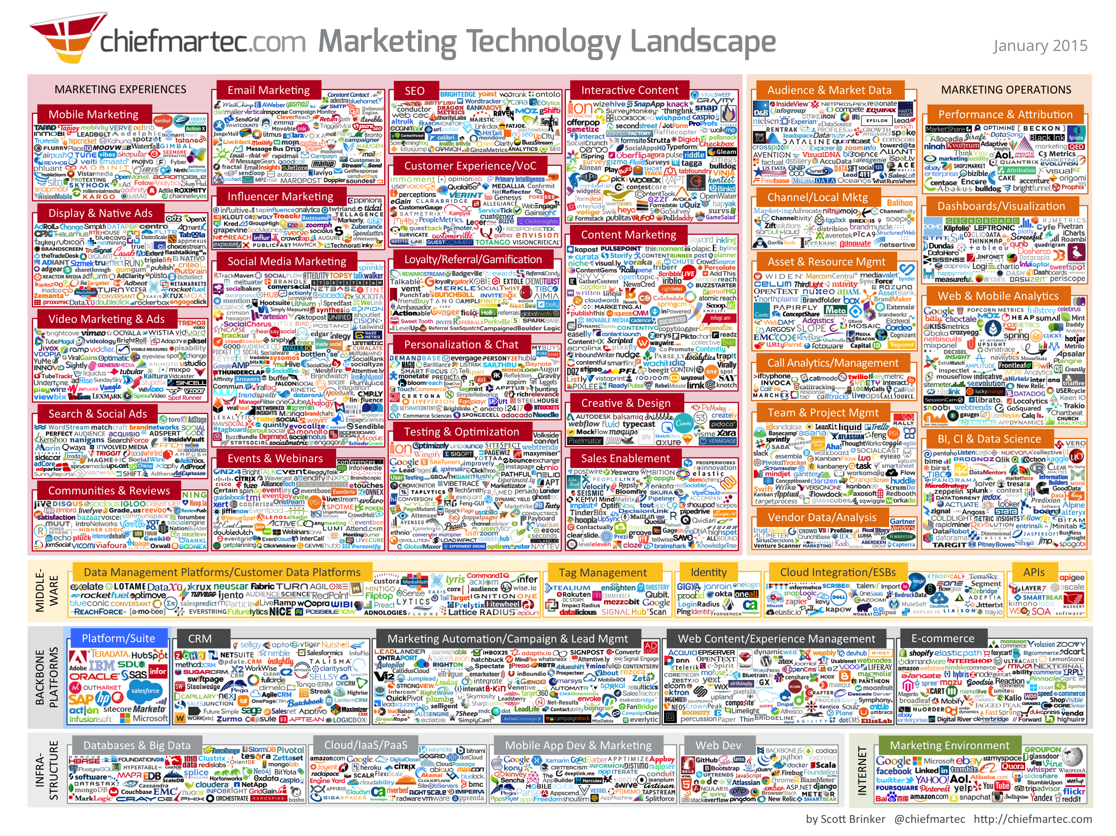

Slide 4
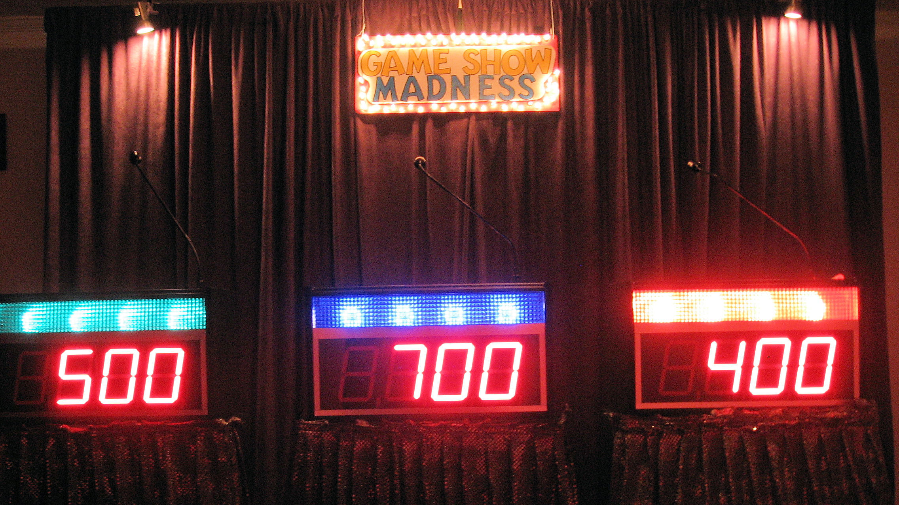
Let’s play NAME THAT PROFESSION

Slide 5
A) Marketing
B) Software Development

Slide 6
?
?

Slide 7
Analytical
Creative

Slide 8
Analytical
Programming
Creative
Design

Slide 9
Analytical
Programming
Automation
Creative
Design
Experience

Slide 10
No fair!
Both professions have all of those things!
Software Development
Marketing

Slide 11
Digital World
Software Development
Marketing

Slide 13
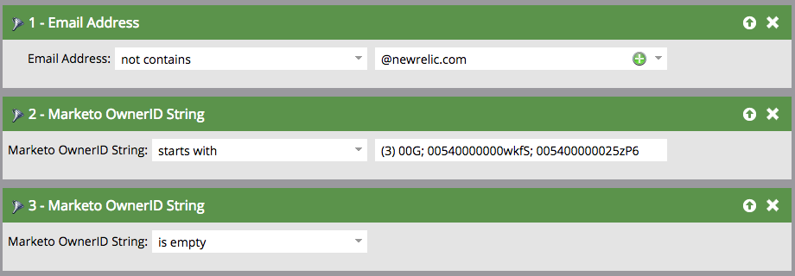
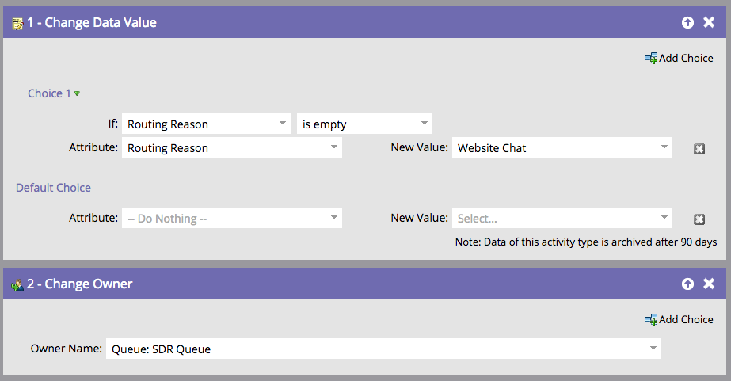
Thinking Like an Engineer
In Marketing Automation
In Pseudo Code
for(MktoLead lead in leads[]){
if (!lead.email.contains(@newrelic.com) &
lead.mktoOwnerID = “005400000025zP6” &
lead.source = “Website Live Chat”){
if(lead.routingReason.isempty()){
lead.routingReason = “Website Chat”
}
lead.ChangeOwner(“Queue: SDR Queue”)
}
}
Source: Isaac Wyatt, New Relic, presentation at MarTech 2015
Notes:
Think like an Engineer:
Marketing Automation IS coding!
Allows you to better understand the complex system of Marketing Automation
Capture more value from creative hacks to get more out of your Marketing Automation
Create a better customer experience throughout the customer lifecycle

Slide 14
?
?
“Requirements keep changing before I get things done!”
“My technology stack is way too complex!”
“I can’t keep up with all these new tool updates!”
“Wait, it doesn’t work on which mobile browser?”
“My job is totally interrupt-driven!”

Slide 15
What can marketers learn from software developers?

Slide 16
Agile & Lean

Slide 17
Plan
Design
Deploy
Review
time
One 6-month plan — waterfall style.

Slide 18
The same 6-month mission — implemented in eight 3-week sprints.
time
1
2
3
4
5
6
7
8

Slide 19
Waterfall vs. Agile
Plan
Design
Deploy
Review
time
1
2
3
4
5
6
7
8

Slide 20
each sprint is an opportunity to:
• respond to new events and information
• deploy viable work into the market sooner
• adjust your approach based on feedback
• stop wasting time on ineffective programs
• experiment with innovative, new ideas
time
1
2
3
4
5
6
7
8

Slide 21
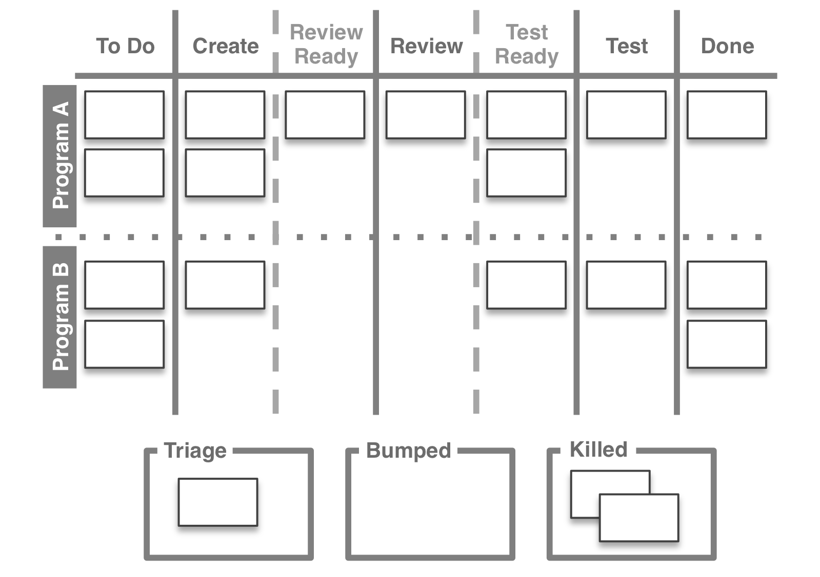

Slide 22
Innovation

Slide 23
how and where it appears
the art of communications
Media
Messages
what it says
“The medium is the message.”
– Marshall McLuhan

Slide 24
the art of customer experience
how and where it appears
Media
Messages
what it says
what it does
how it behaves
Mechanisms

Slide 25
how and where it appears
Media
Messages
what it says
CX
what it does
how it behaves
Mechanisms

Slide 27
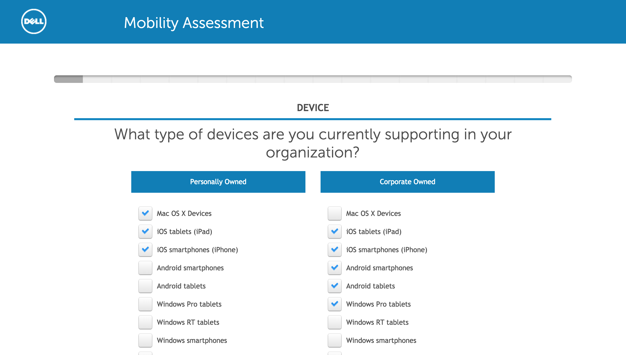

Slide 28
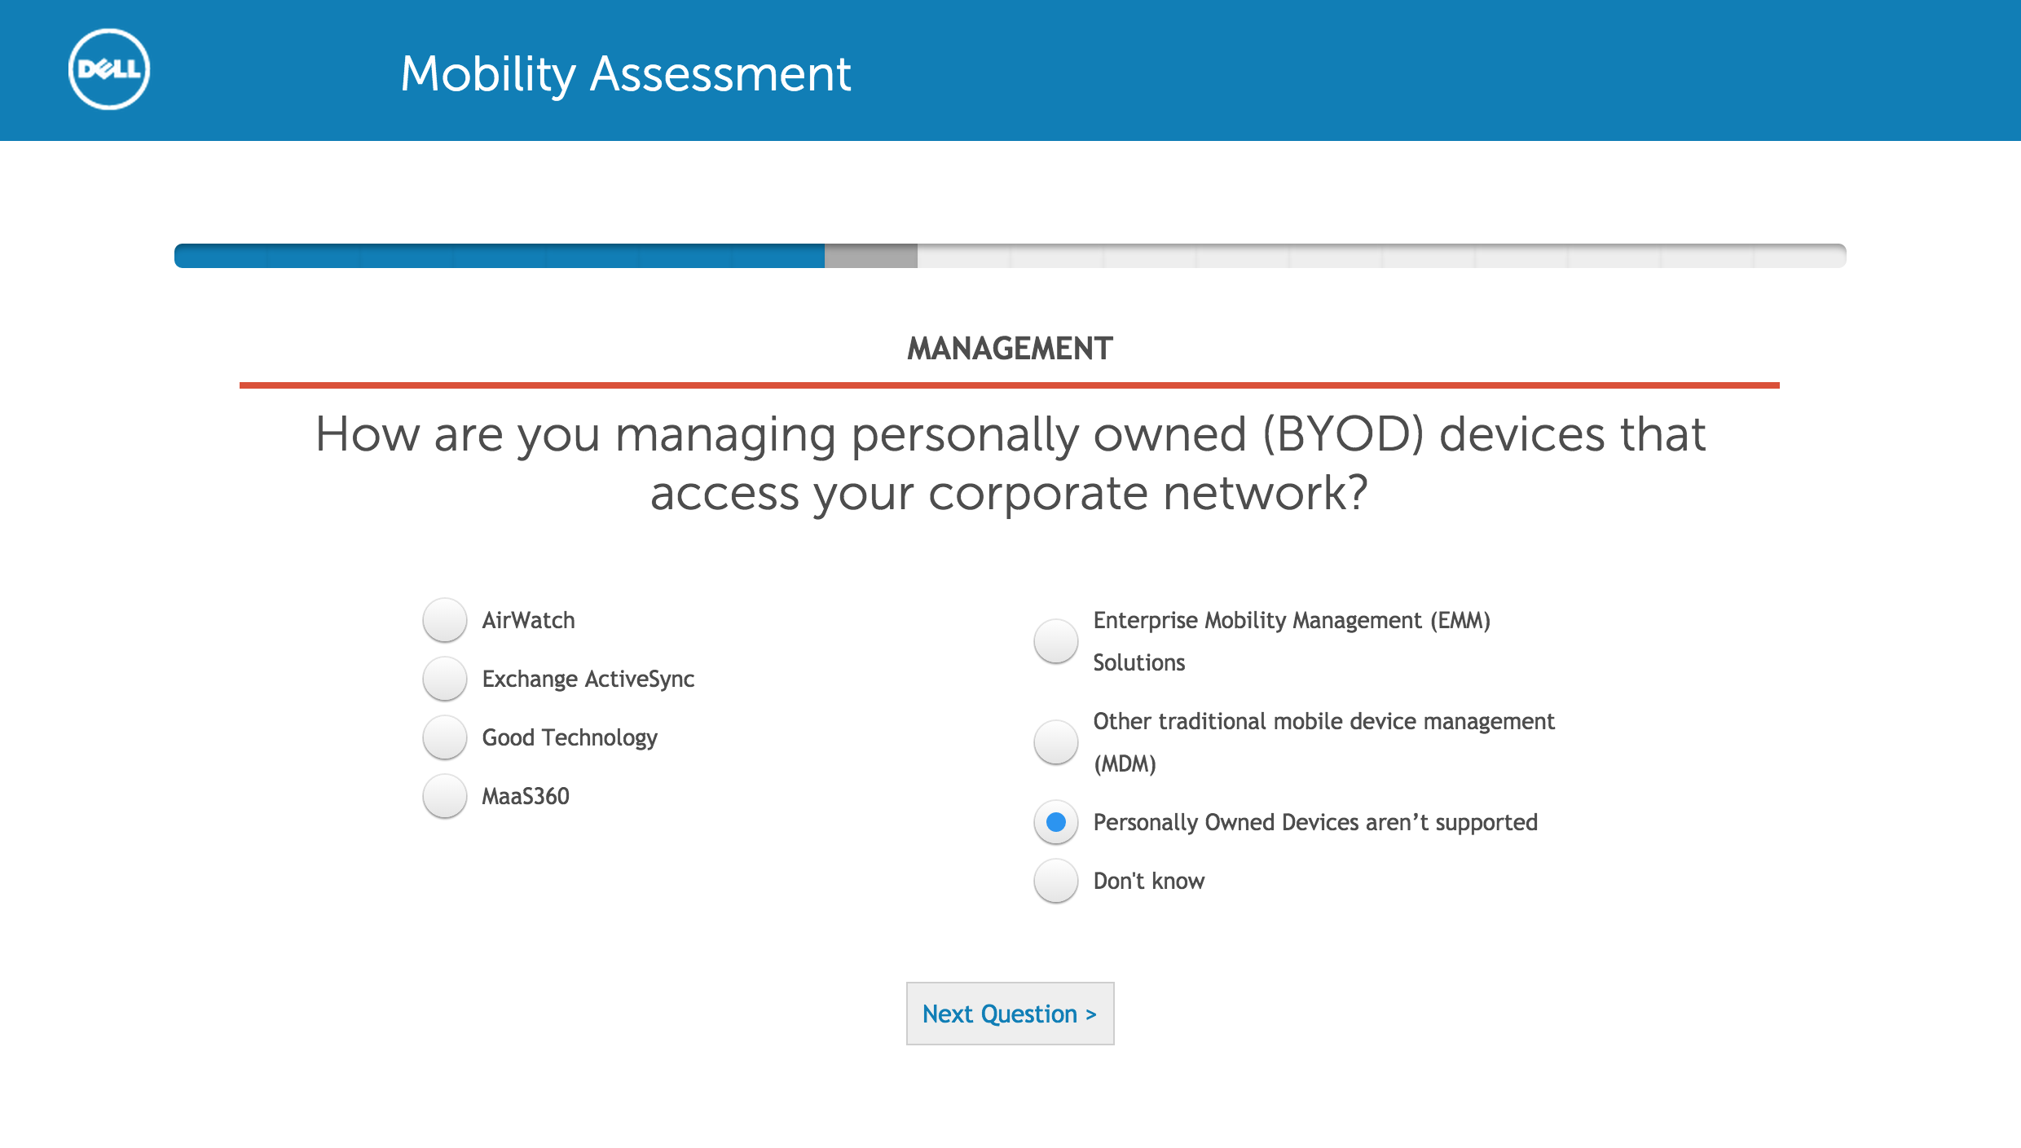

Slide 30
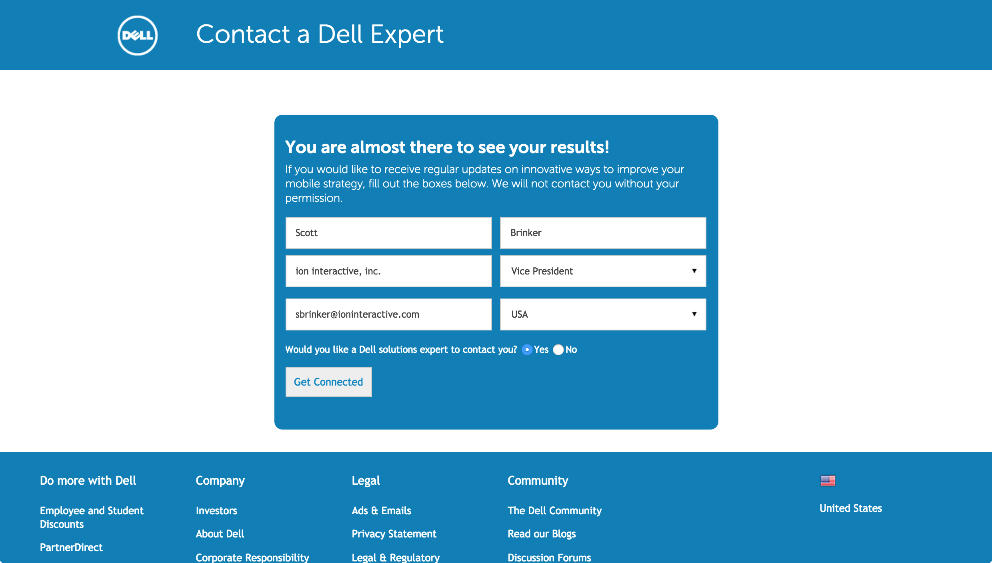

Slide 32
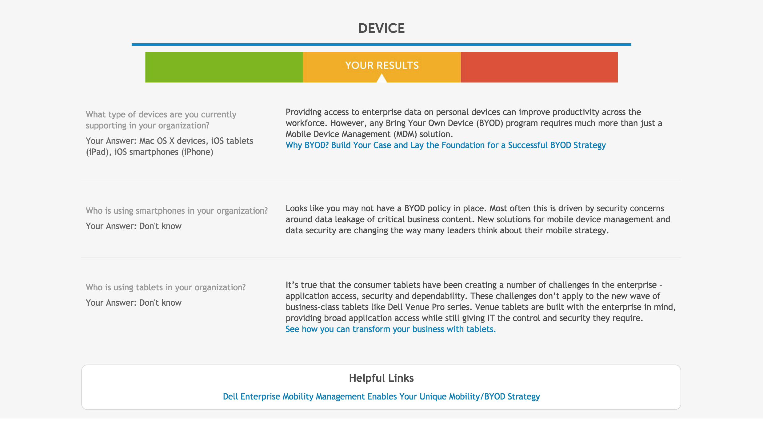

Slide 35
Marketing
Media
Messages
CX
customer experience
Mechanisms
marketing managers

Slide 36
Software
UI
Data
UX
user experience
Code
product managers

Slide 37
Marketing
Software
Media
Messages
UI
Data
CX
≈
UX
Mechanisms
Code
marketing managers
product managers

Slide 38
Scalability

Slide 39
Innovation
Scalability
Experimentation
Standardization
Explore
Exploit
“Fail Fast”
“Fail Not”
Question Assumptions
Leverage Assumptions
Speed
Dependability

Slide 40
Can we manage both with one framework?
No, but we can manage them with two…

Slide 41
Bimodal marketing
Many innovations are explored on the edge.
30%
Majority of investment allocated to the core, but wider exploration on the edge.
70%
Core
Only a few are scaled into the core.
Edge

Slide 42
Bimodal marketing
Transition from the edge to the core is carefully controlled — like a “stage gate” innovation process.
Transition
Core
It’s okay for non-scalable programs to remain in the edge.
Edge

Slide 44
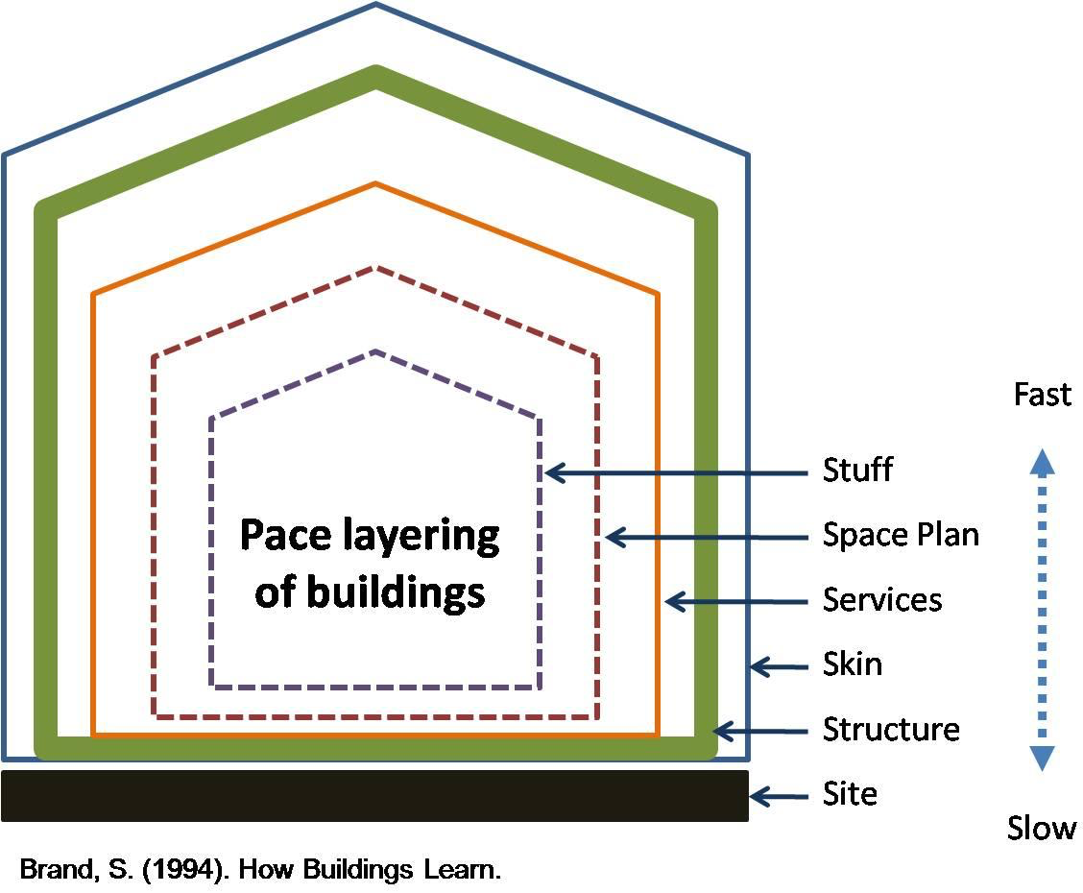

Slide 45
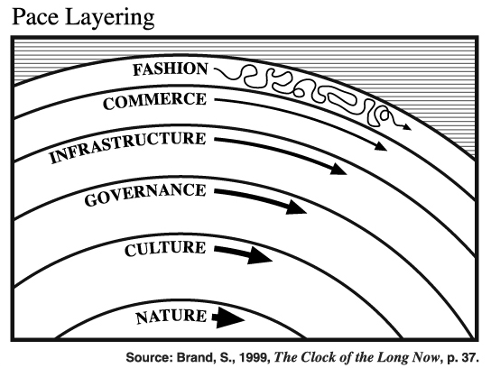

Slide 46
Feedback
real-time
social media, metrics
fast
Iteration
days
A/B testing, personalization
Tactic
communications, experiences
Channel
weeks
media mix, context framing
pace of change
Marketing Pace Layers
Campaign
concept, audience, messaging
months
Brand
positioning, value proposition
years
Company
corporate culture, values, image
slow

Slide 47
pace layers apply to:
fast
• marketing strategy
• marketing operations
• marketing technology stack
• website design
• marketing data
slow
pace of change
Design governance and architecture to facilitate layers changing at their own pace.

Slide 48
Talent

Slide 50
“Great designs come from great designers.”
– Fred Brooks

Slide 51
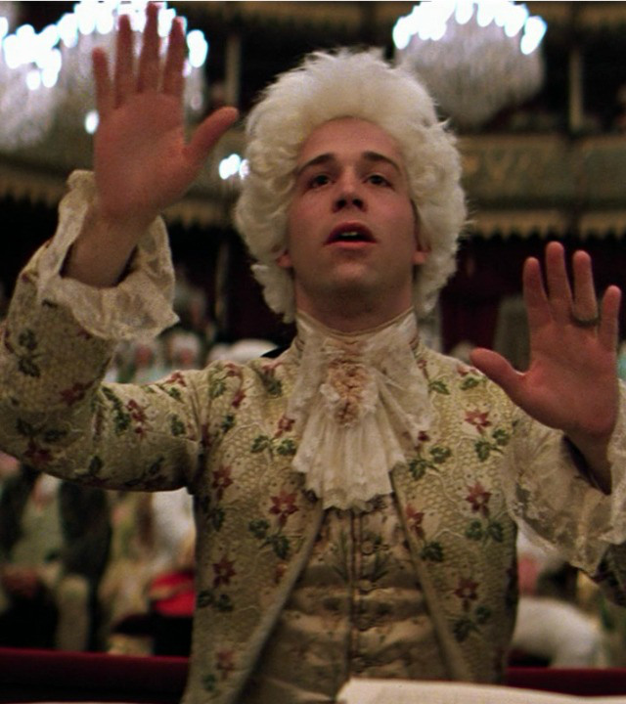
“The differences are not minor – they are rather like the differences between Salieri and Mozart.”
– Fred Brooks

Slide 52
“The difference between the great and the average approach an order of magnitude.”
– Fred Brooks

Slide 53
The “Myth” of the 10X Engineer

Slide 54
Talent
Opportunity
Leverage

Slide 55
The “Myth” of the 10X Marketer

Slide 56
Email me at:
sbrinker@chiefmartec.com
Twitter: @chiefmartec
ion interactive, inc. http://ioninteractive.com
Chief Marketing Technologist http://chiefmartec.com
MarTech Conference http://martechconf.com

