Slide 1

New Frontiers
in Digital Distribution
Notes:
Welcome to the start of the Publishing Track! I’m Mark Walter, and I’ll be the moderator for this opening session.
We have an interesting series of sessions for you this afternoon and tomorrow, and we are going to start with a panel that sets some context by looking at how the digital media landscape is changing today and what that might mean for different types of publishers- whether those be commercial publishers or corporate.
We have a great panel – Brad Kagawa, the VP Technology, Content Management Systems, @ The New York Times. Brad Spoke last year, and Frank and I invited him back. Also joining us is Jay Brodsky, principal at Align Digital Consulting and the former CTO at Atlantic Media, and third, Eric Hellweg, Managing Director, Digital Strategy, Harvard Business Review.
Together they bring news, consumer and professional publishing perspectives, as well as technology and business backgrounds so that we can look at where we’re going from several points of view.
I’m going to first start by setting a little context, and then we’ll move into a panel discussion, and once that gets rolling I invite all of you to join in with questions or comments.

Slide 2
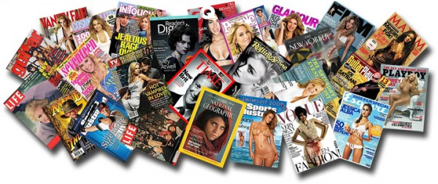
2000 - 2005
Pre-Social: Print / Web / TV-Cable
Notes:
I’d like to start with a very quick 5-minute look back to see how we came to where we are.
If we roll back the clock to the beginning of the century, commercial consumer publishers made their money from print but were actively experimenting with the web and many were also extending their brand to television or cable.
The shift from print to digital revenues happened more quickly in professional sectors – STM publishing, for example, where we have Elsevier speaking tomorrow.
But in an era that was before social networking took off, the digital focus was on the web; money was still in print and broadcast

Slide 3

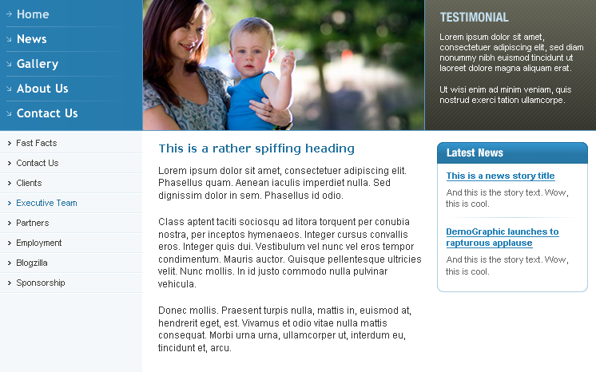
2005 - 2010
The Site-Centric Approach to Social
Drive traffic to web site, monetize visitors
Social as Marketing
www.your-site-here.com
Notes:
As social media gained traction, media companies, and for that matter corporate marketers as well, treated social media as a lead-generation tool- people posted or tweeted and that drove traffic back to my web site where I hoped to “monetize” visitors, either by selling ads against impressions or encouraging visitors to subscribe.
It was brand awareness in a good way, because people were led back to a platform that I controlled.

Slide 4
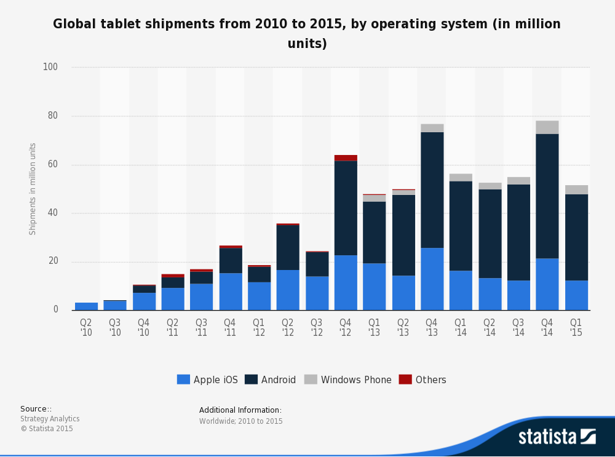
2010 - 2015
The Rise and Slowdown of Tablets
Portable reading for more than just novels
Spawns wave of publisher / brand apps
Major driver for responsive design
Notes:
2010 – the iPad changes digital delivery –
First portable handheld multipurpose computer with a color display that is great for reading.
I know in our house it completely changed our “home computing” experience – we abandoned laptop at home for everything that didn’t require a dedicated keyboard or office applications.
It was a new delivery platform, used gestures instead of a mouse, a different form factor– had very interesting possibilities for interactive and expanded content
Best of all, I could publish under my own branded app –with in-app messaging direct from publisher to consumer, and a new ecosystem for payment, subscriptions or memberships.
People who subscribed by iTunes did so without me knowing who they were, but even so publishers with their own apps had a good bit of control.
2 Other points:
1: Huge driver for responsive design, which then made it much easier for sites to be phone friendly
That’s not wasted efforts. So while tablets are still selling well, you can see the trend – they have already peaked, and what’s growing now are large phones.

Slide 5
2014 Milestones
The number of global internet users passed 3 billion in early November 2014
> Users on social media passed 2 billion in August 2014
42% of the world's population now uses the Internet
> up from 35% in 2013
The worldwide penetration of mobile phones passed 50% in September—
> 51% of the world’s population now has a mobile phone
Almost half of the world's internet users live in Asia-Pacific
> That share is increasing
Notes:
- See more at: http://www.fipp.com/news/insightnews/4-milestones-from-the-digital-world-in-2014#sthash.b48LWqCc.dpuf

Slide 6
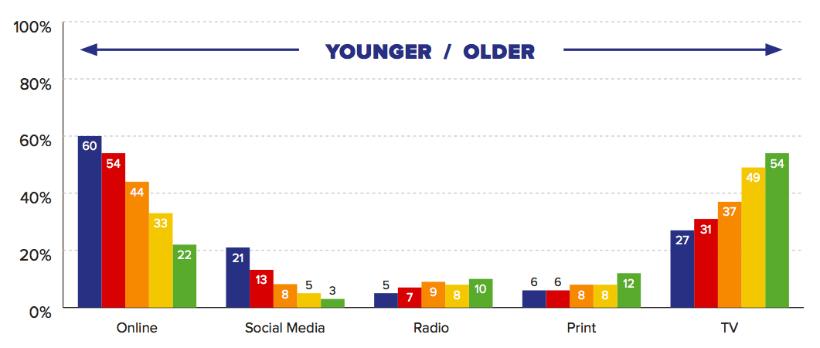
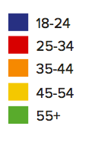
Main Source of News By Age
Q4. You say you’ve used these sources of news in the last week, which would you say is your MAIN source of news? Base: All who have used news sources in the last week =23155
Source RISJ Digital News Report 2015
Notes:
Which brings us to today’s conversation.
Today, more people visit web sites or news apps to get news than they do social networks.
But that is changing- 40% growth from 2014 to 2015 in shares of news content on Facebook
Facebook owns WhatsApp, which is huge outside the U.S.
Facebook owns Instagram

Slide 7
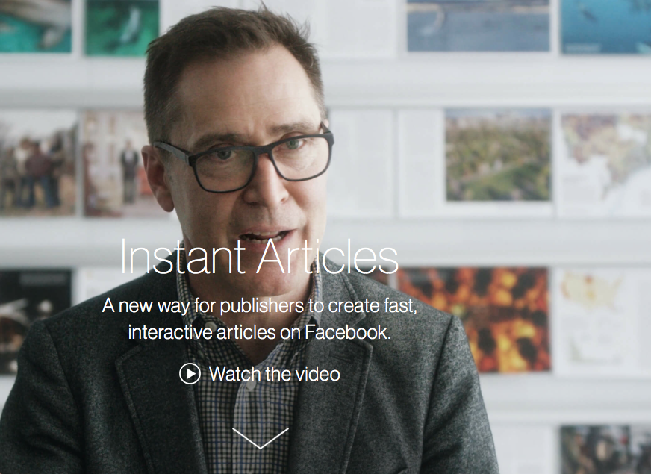
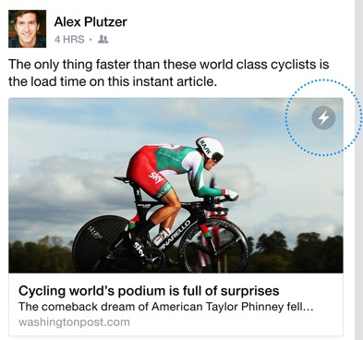
Notes:
And now Facebook introduces Instant Articles, its own news platform
No, it’s not yet running a news organization, but it is controlling the delivery, and the relationship with the consumer

Slide 8
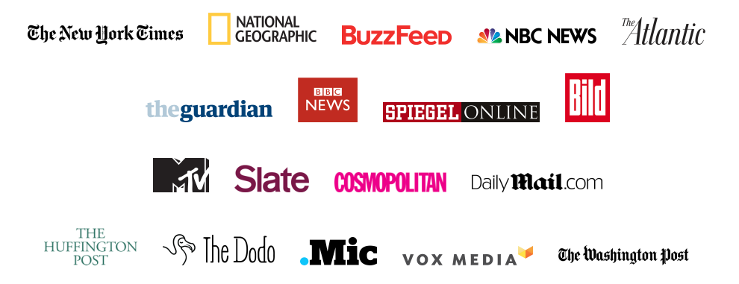
Billboard, Billy Penn, The Blaze, Bleacher Report, Breitbart, Brit + Co, Business Insider, Bustle, CBS News, CBS Sports, CNET, Complex, Country Living, Cracked, Daily Dot, E! News, Elite Daily, Entertainment Weekly, Gannett, Good Housekeeping, Fox Sports, Harper’s Bazaar, Hollywood Life, Hollywood Reporter, IJ Review, Little Things, Mashable, Mental Floss, mindbodygreen, MLB, MoviePilot, NBA, NY Post, The Onion, Opposing Views, People, Pop Sugar, Rare, Refinery 29, Rolling Stone, Seventeen, TIME, Uproxx, US Magazine, USA Today, Variety, The Verge, The Weather Channel.
Who’s In?
Billboard, Billy Penn, The Blaze, Bleacher Report, Breitbart, Brit + Co, Business Insider, Bustle, CBS News, CBS Sports, CNET, Complex, Country Living, Cracked, Daily Dot, E! News, Elite Daily, Entertainment Weekly, Gannett, Good Housekeeping, Fox Sports, Harper’s Bazaar, Hollywood Life, Hollywood Reporter, IJ Review, Little Things, Mashable, Mental Floss, mindbodygreen, MLB, MoviePilot, NBA, NY Post, The Onion, Opposing Views, People, Pop Sugar, Rare, Refinery 29, Rolling Stone, Seventeen, TIME, Uproxx, US Magazine, USA Today, Variety, The Verge, The Weather Channel.
Notes:
Who is in?
Who is about to join?
Billboard, Billy Penn, The Blaze, Bleacher Report, Breitbart, Brit + Co, Business Insider, Bustle, CBS News, CBS Sports, CNET, Complex, Country Living, Cracked, Daily Dot, E! News, Elite Daily, Entertainment Weekly, Gannett, Good Housekeeping, Fox Sports, Harper’s Bazaar, Hollywood Life, Hollywood Reporter, IJ Review, Little Things, Mashable, Mental Floss, mindbodygreen, MLB, MoviePilot, NBA, NY Post, The Onion, Opposing Views, People, Pop Sugar, Rare, Refinery 29, Rolling Stone, Seventeen, TIME, Uproxx, US Magazine, USA Today, Variety, The Verge, The Weather Channel.
Can we scroll these?

Slide 9
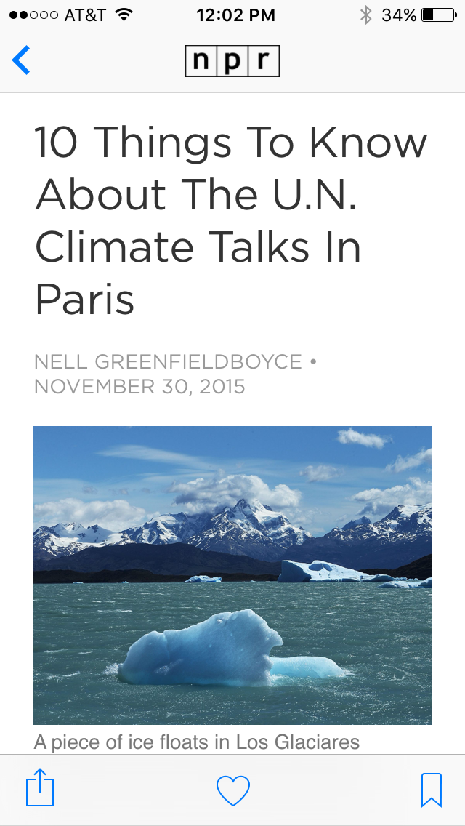
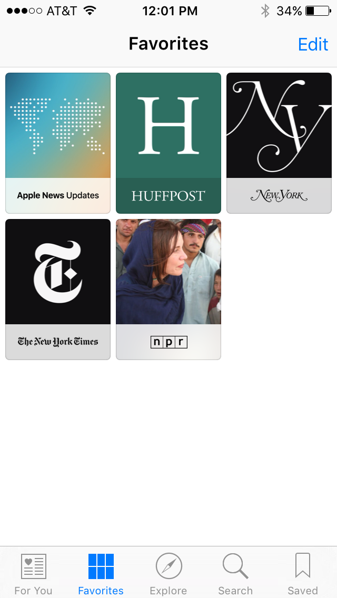
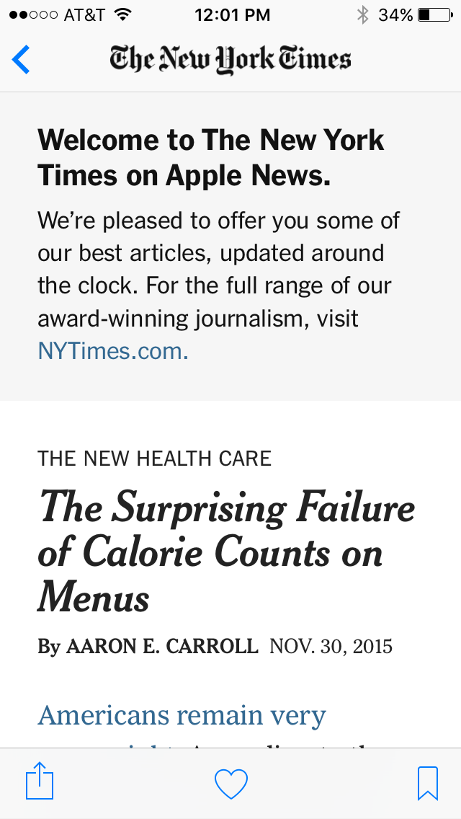

Apple News
Notes:
And though Apple News is an app, not a social media site – at least not yet – here again we have the idea that consumers are reading our stories not under our app but under someone else’s platform

Slide 10

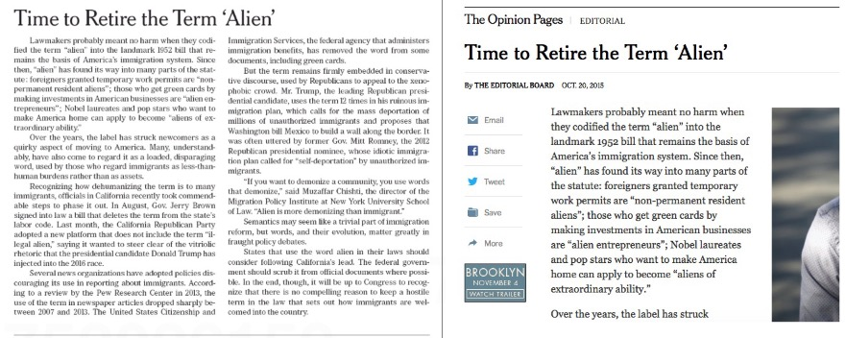

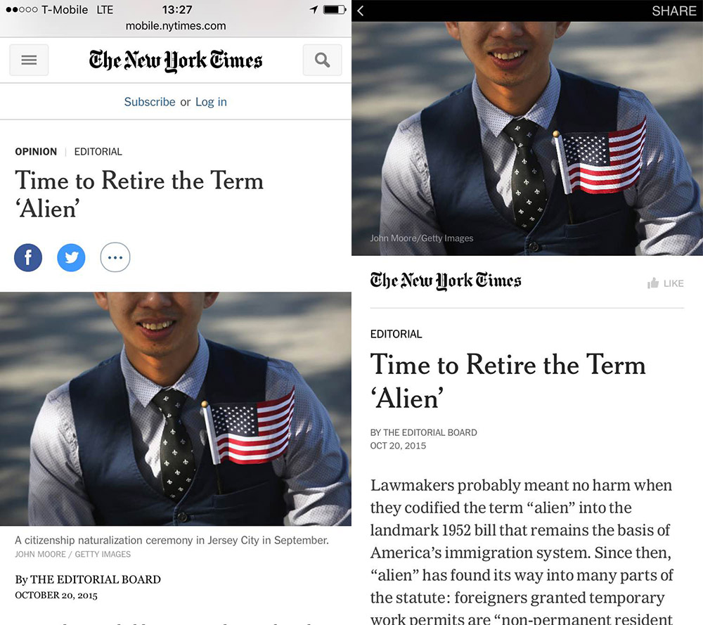
One Story Four Ways
What are the opportunities and costs of associated with an “off-site” delivery platform?
f
Print Edition
(scaled down)
Desktop Web
Mobile Web
Facebook Mobile
Notes:
Which gets us to asking about the cost / benefits of these new platforms
Brad spoke eloquently last year about the challenges of supporting an increasing number of digital platforms – in particular because the Times is sensitive to the reading experience and wants to deliver a great reading experience on every media in which it delivers its products.
Now we have a new platform for news that I don’t own or control
But more importantly, I do not have a direct relationship with the customer at someone else’s platform.

Slide 11
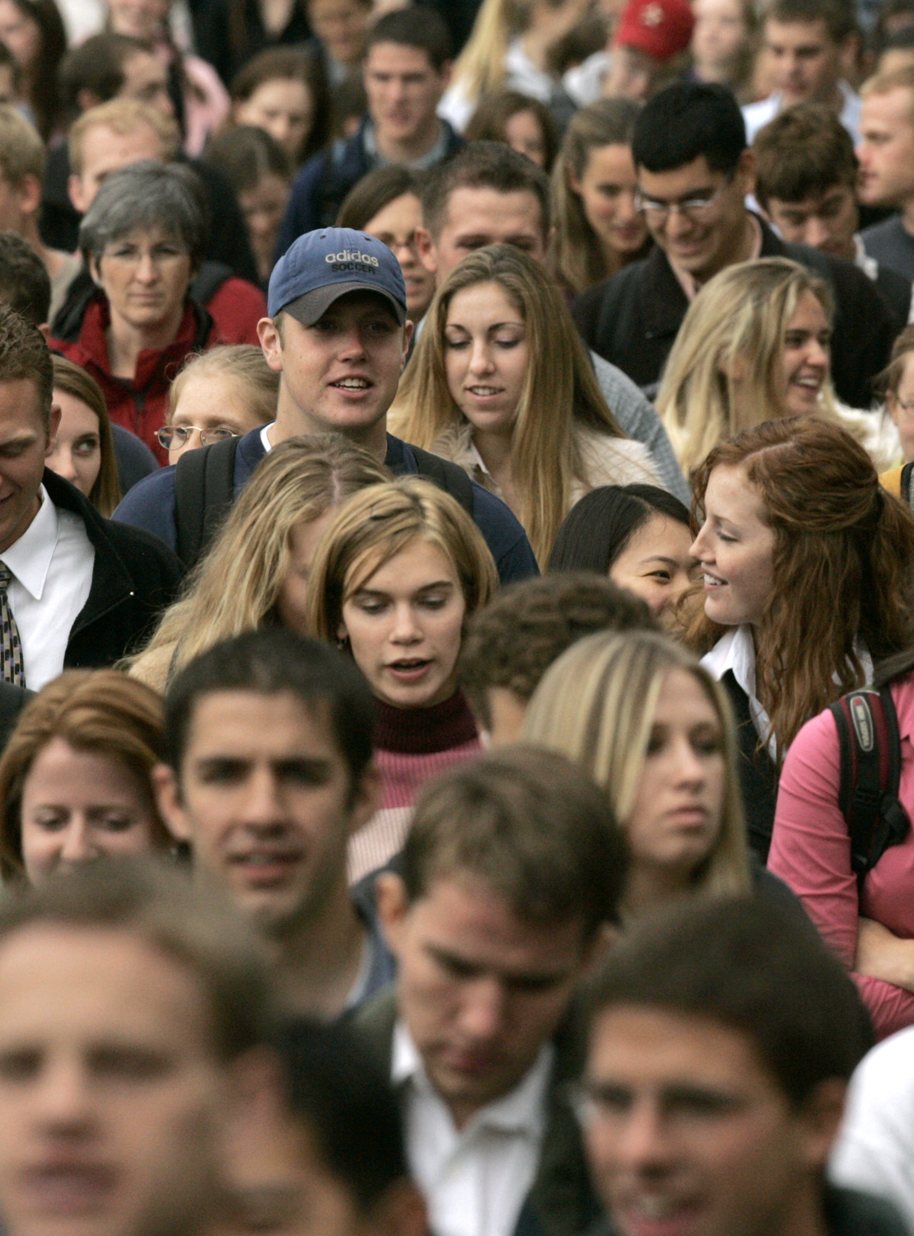

2015 – 201X
Mobile-Social
Social as Network
Social isn’t marketing – it is the delivery network
Notes:
People used to see news on Facebook while they were there for another reason. Going forward, we are seeing more people going to the network for their news, and indeed, for reading in general.
Some are bullish on this. This slide is derived from ideas that Patrick Yee at Refinery 29, a leading digital media company in fashion, presented at the Digital Innovation Summit this summer.
He said his whole company is focused on having the best branded, Original native content – that conventional advertising was not going to cut it in this new era.

Slide 12

“Media companies would essentially be serfs in a kingdom that Facebook owns.”
—David Carr, Oct. 2014
Notes:
Others are no so bullish. A year ago, before he passed away in February, the NY Times media critic David Carr wrote that Facebook was a bit like that big dog galloping toward you in the park.
More often than not, it’s hard to tell whether he wants to play with you or eat you.
And as you can see by the quote here, he was skeptical of Instant Articles.
http://www.nytimes.com/2014/10/27/business/media/facebook-offers-life-raft-but-publishers-are-wary.html?_r=0

Slide 13
Notes:
So with that, let’s turn to our panelists, and I’ll start with Brad.. . I know it’s only been a few months, but what has the NY Times learned so far?
Remainder of session is Q&A with panelists without visuals.

Slide 14
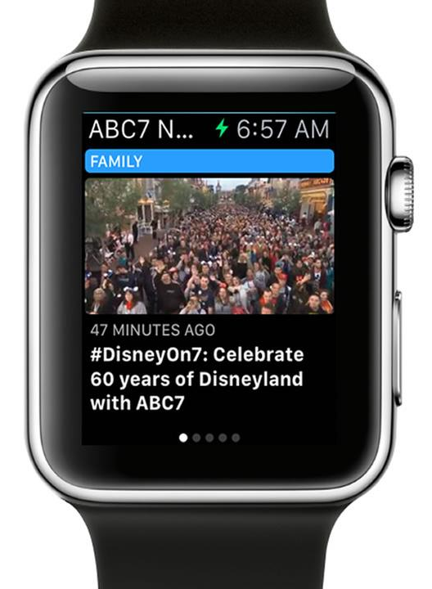
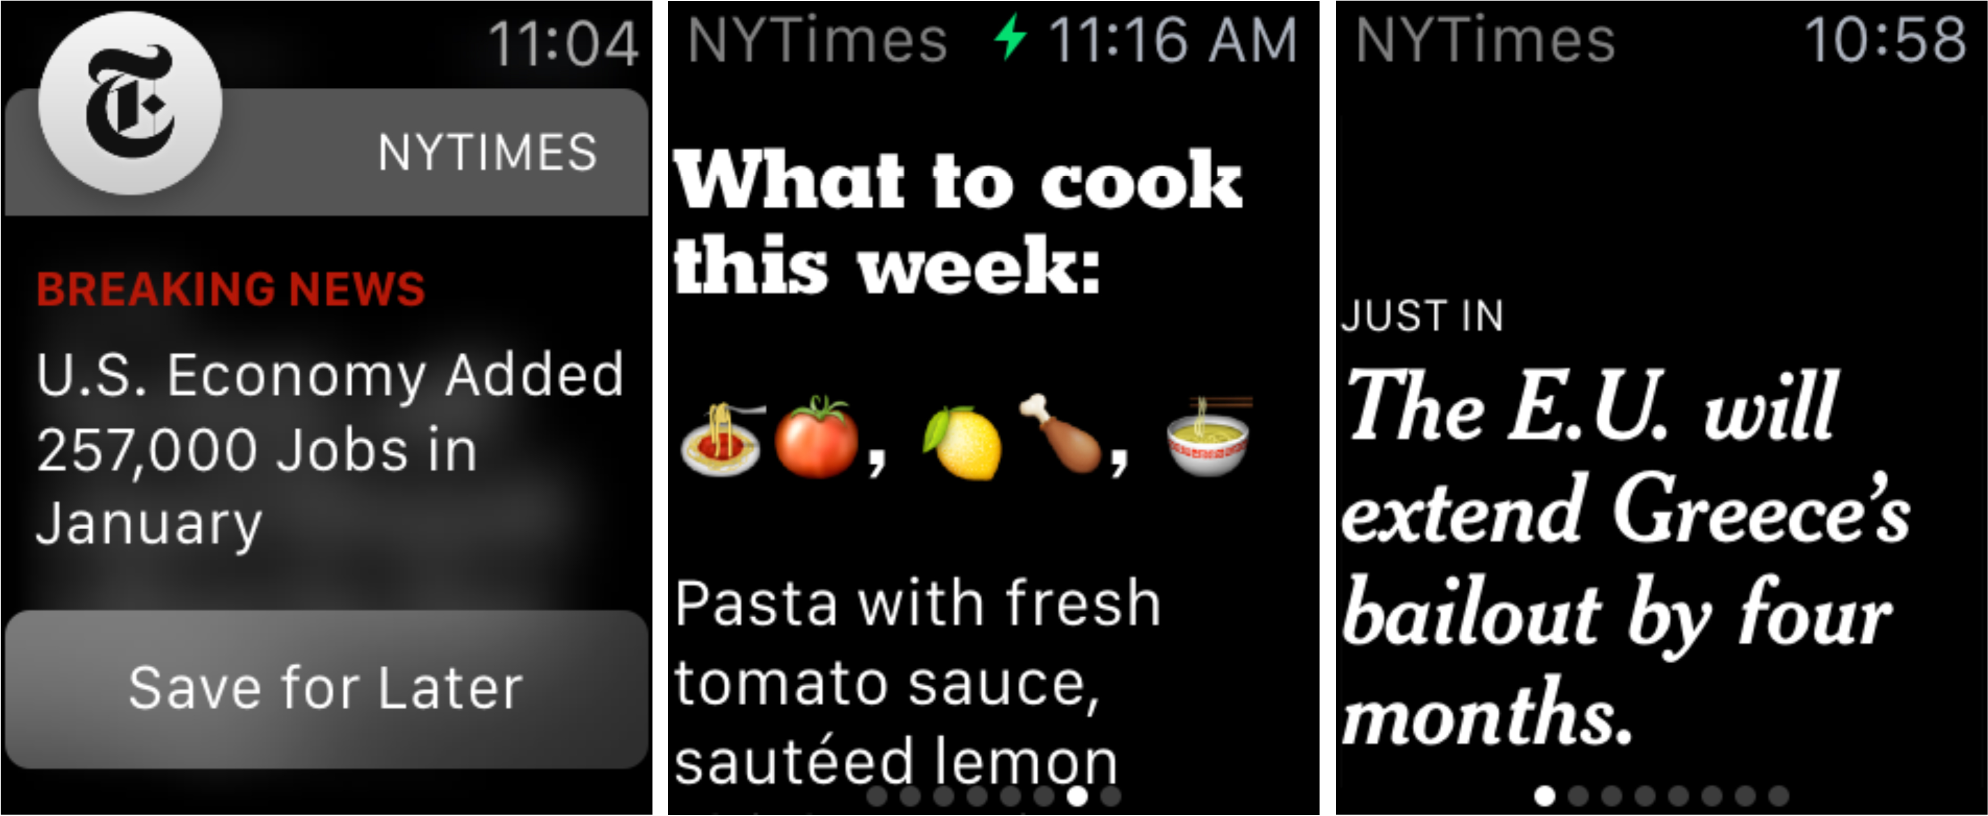
Apple Watch
Notes:
At the same time, the media themselves keep changing.
So the Apple Watch is completely different - it’s a device, not a network, but as far as new frontiers it represents one that was precedent setting

