Slide 1
Beyond Structural Markup - Practical Approaches to Semantic Markup - San Francisco, May 20th 2010
Semantic Technologies
Marc Haines
Senior Architect, Ictect Inc.

Slide 2
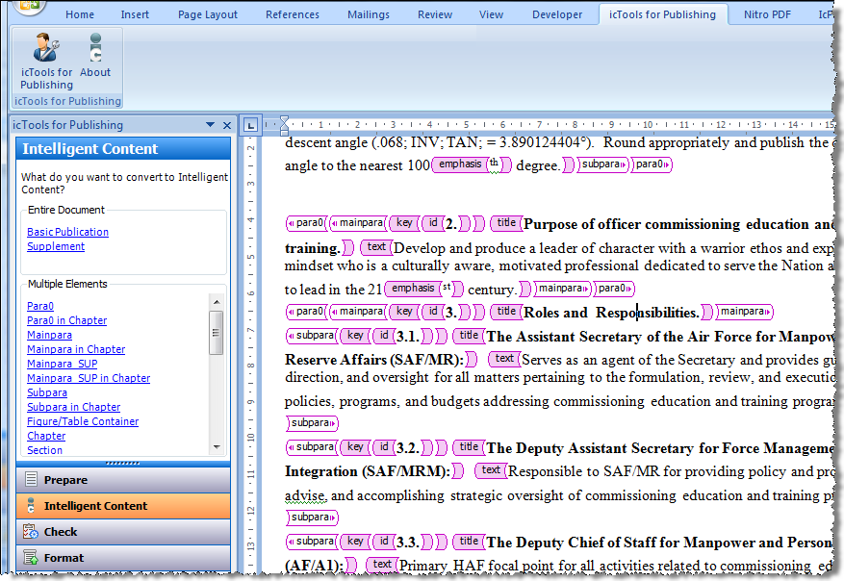
Beyond Structural Markup
Structural Markup

Slide 3
Beyond Structural Markup
Semantic Markup Approach
Knowledge about content is gained incrementally through enhancement of context
Leverage structural context
Iteratively add inline “semantic” elements
Iteratively complete attributes of elements

Slide 4
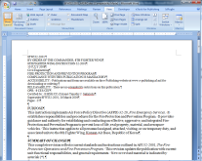
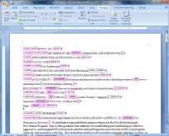
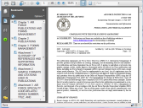
Beyond Structural Markup
Iterative semantic tagging approach
Raw
Document
Structural
Markup
Published
Content
Semantic
Markup
Published
Content
Published
Content

Slide 5
Beyond Structural Markup
Applications:
Financial Footnotes in SEC Filings
Markup of narrative in footnotes
Healthcare
Markup of narrative in discharge summaries

Slide 6
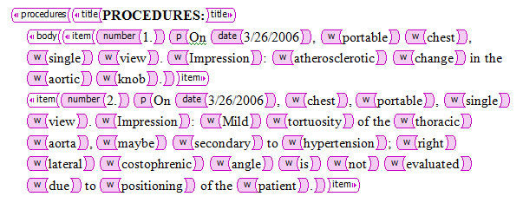
Beyond Structural Markup
Applications:
Healthcare
Markup of narrative in discharge summaries
Raw document
Structural
Markup
Semantic
Markup
Attributed with ICD codes

Slide 7
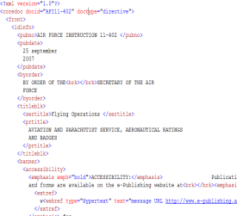
Beyond Structural Markup
Applications
Healthcare
Medical Information
Services
ICD-10
/ SNOMED
Word
icTools
for HealthCare
Word + XML
Hospital Info. Sys.
XML
(e.g., HL7)
Content Repository

Slide 8
Beyond Structural Markup
Thank You
Marc Haines
marc.haines@ictect.com

