Slide 1
Listening to the Future
An Introduction to Management by Design
Daniel W. Rasmus
Author, Listening to the Future
dwrasmus@danielwrasmus.com
danielwrasmus.com
Put Your Future in Context
© 2010 by Daniel W. Rasmus

Slide 2






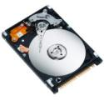








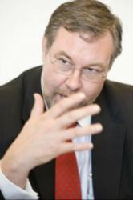



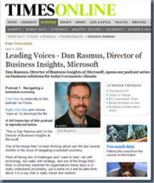






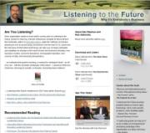









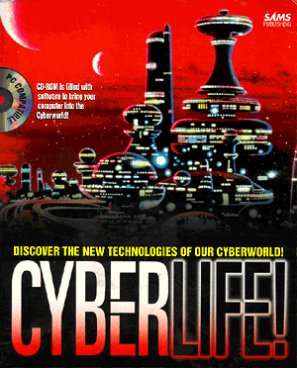


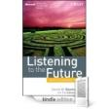






Daniel W. Rasmus
Dan
How I do my work
Read, listen, read
Education
conferences
economist.com
newscientist.com
NPR.org
Continuous Learning
FT.com
Career
Western Digital
Hughes
Community
Wired.com
Questions from
Customers &
Students
Uncertainties
Scenarios
Uncertainties
Poetic Moments
listeningtothefuture.com
Read All About It!
danielwasmus.wordpress.com
Share
DanielWRasmus
future-of-work.spaces.live.com

Slide 3


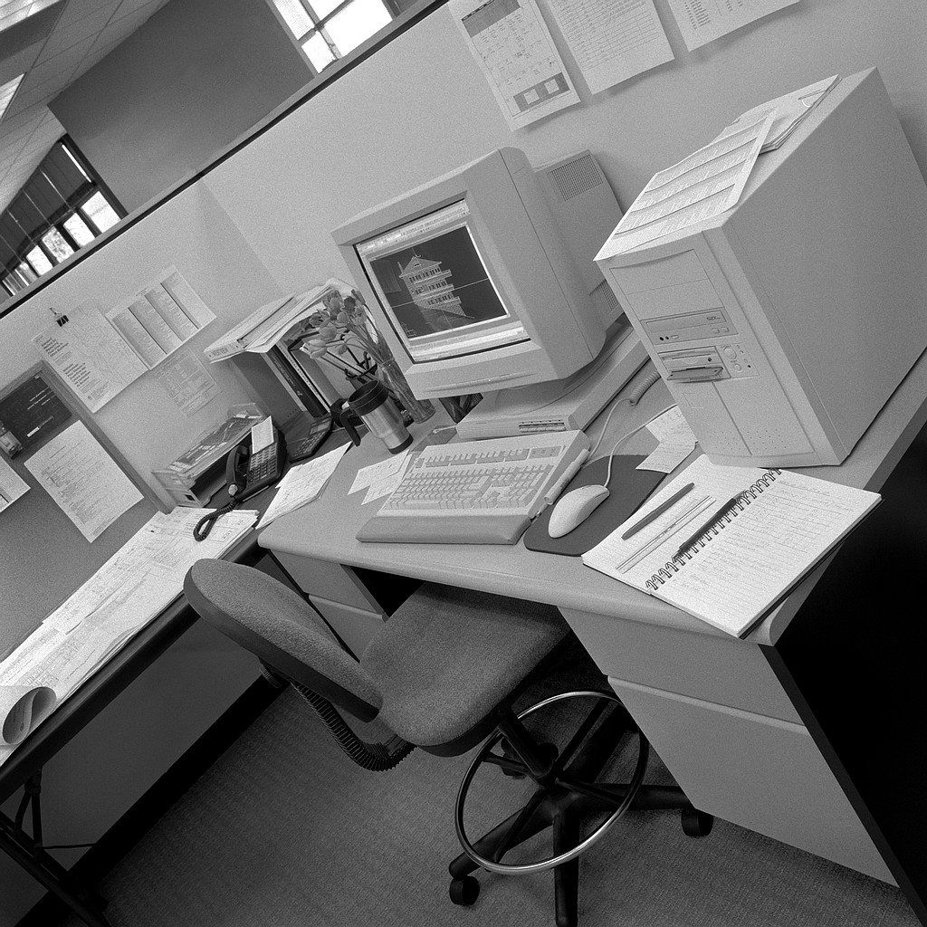


Agenda
Go Inside
Go Outside

Slide 4


Slide 5
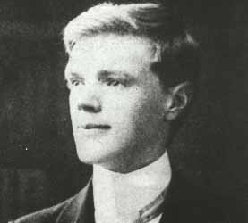
Design in art, is a recognition of the relation between various things, various elements in the creative flux. You can’t invent a design. You recognize it, in the fourth dimension. That is, with your blood and your bones, as well as with your eyes.
D.H. Lawrence

Slide 6
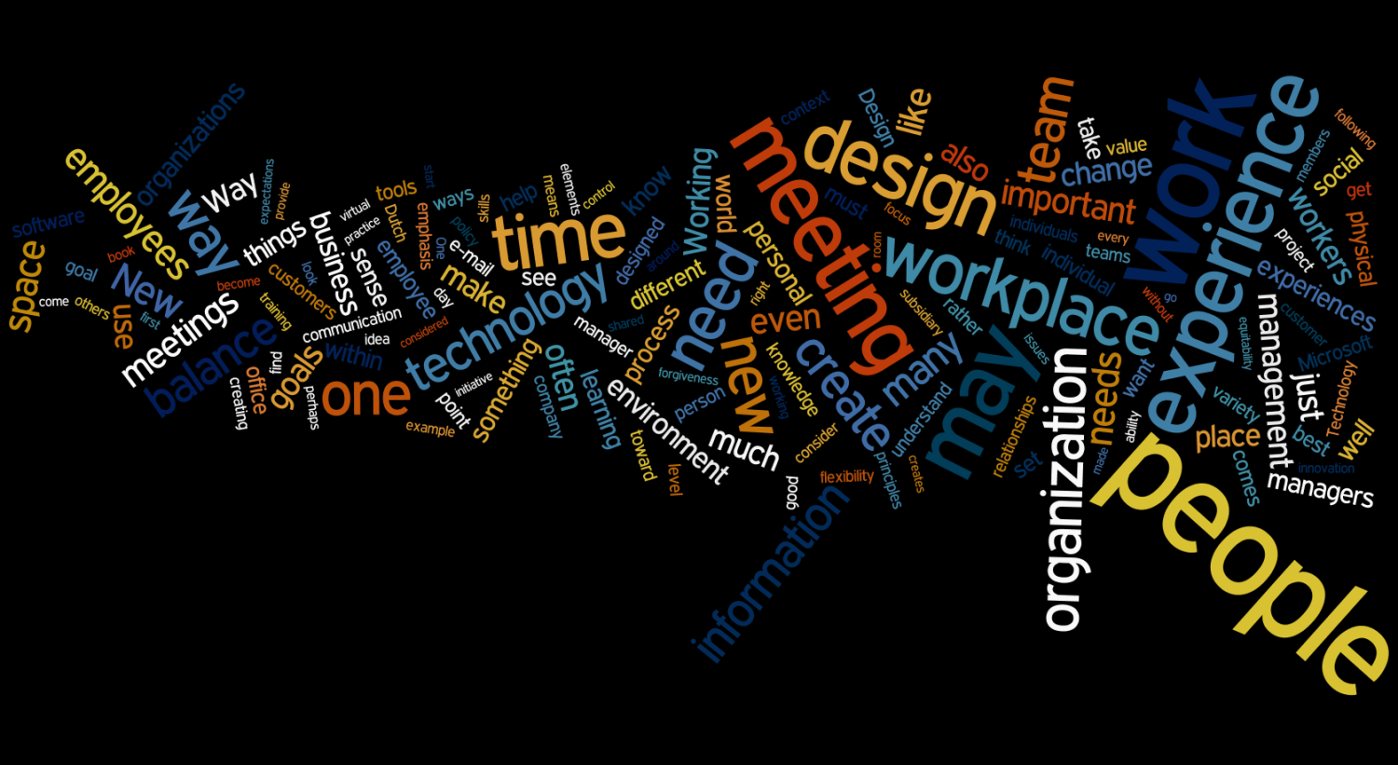
Management by Design Preview

Slide 7






Motivations
1946-1964
80 M
Baby Boom
GenX
46 M
1964-1980
76 M
Generation Blend
Millennials
1980-2000

Slide 8

Finding Balance

Slide 9


Emphasis and Variety

Slide 10
Proportion
Knowing
Innovation
Doing
Efficiency

Slide 11
Influence
Policy & Practice
Technology
Space
Simplicity
Forgivability
Equitability
Flexibility

Slide 12
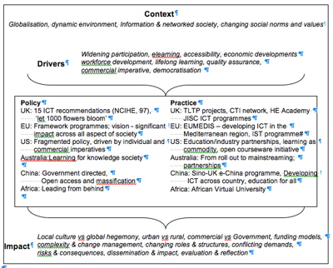
Policy and Practice
Examples
Workplace engagement
Meeting management
Telecommuting
Financial reporting and expenses
Team dynamics
Line management communication
Strategy transparency and communication
Software environment policy

Slide 13
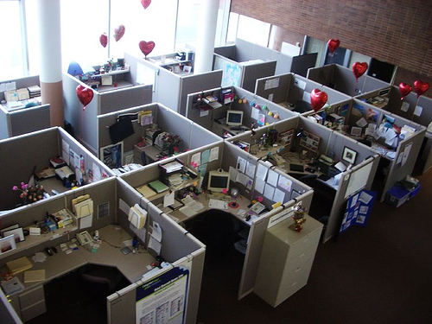
Space – The Cubical Farm

Slide 14
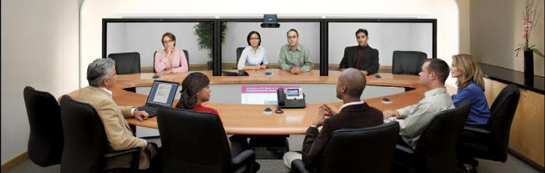


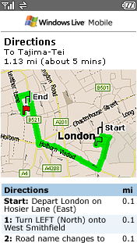

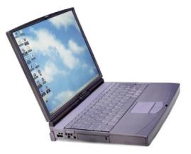
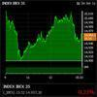
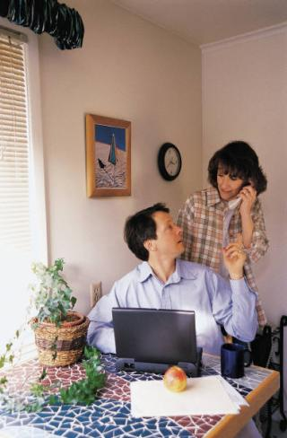



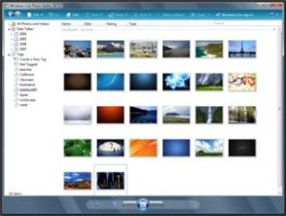


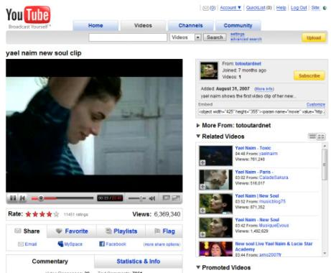

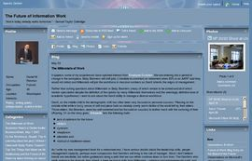

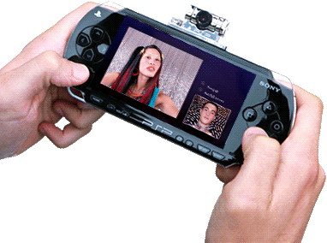
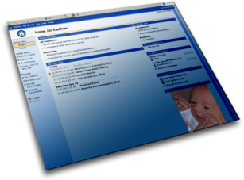




Technology
Tags Rating
Widgets Content
Collaborative Filtering
Aggregation
Notes:
Widgets and components

Slide 15
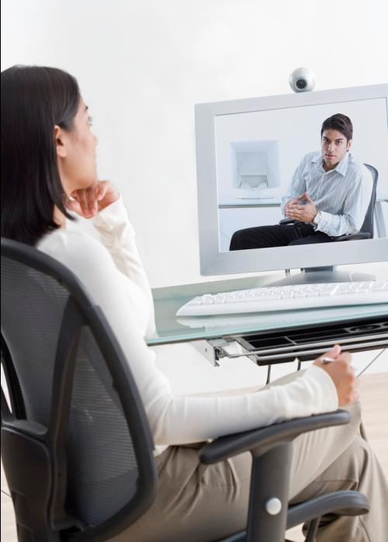

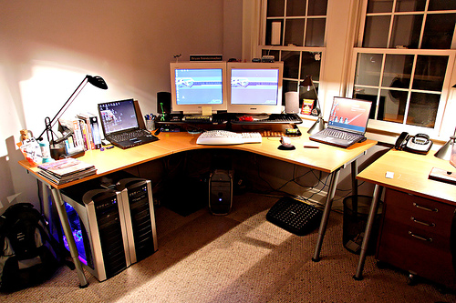


Slide 16

Rhythm and Motion
Schedule
Goals
Impact
Objectives

Slide 17
Perceptibility
Who
What
Where
When
Why
How

Slide 18
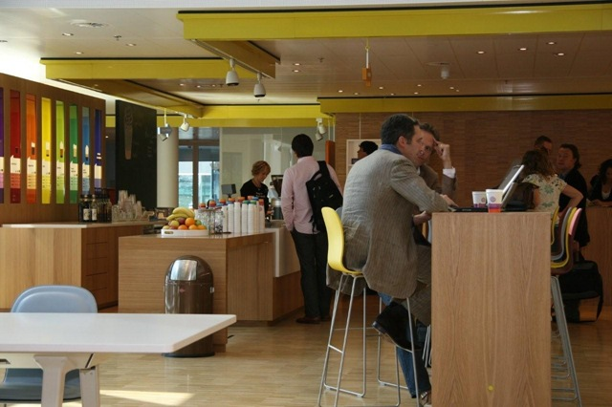
Microsoft Netherlands

Slide 19
Management by Design
Balance
Variety and Emphasis
Proportion
Rhythm and Motion
(Strategic Measures)
Goal or
Objective
E
Policy and Practice
Technology
Space
S
F₁
Perceptibility
(Tactical Measures)
Who?
What?
Where?
When?
Why?
How?
F₂

Slide 20

Go Outside
The Universe Has No Center

Slide 21



Go Global
The Frontiers of Innovation
Language Context Domain knowledge

Slide 22
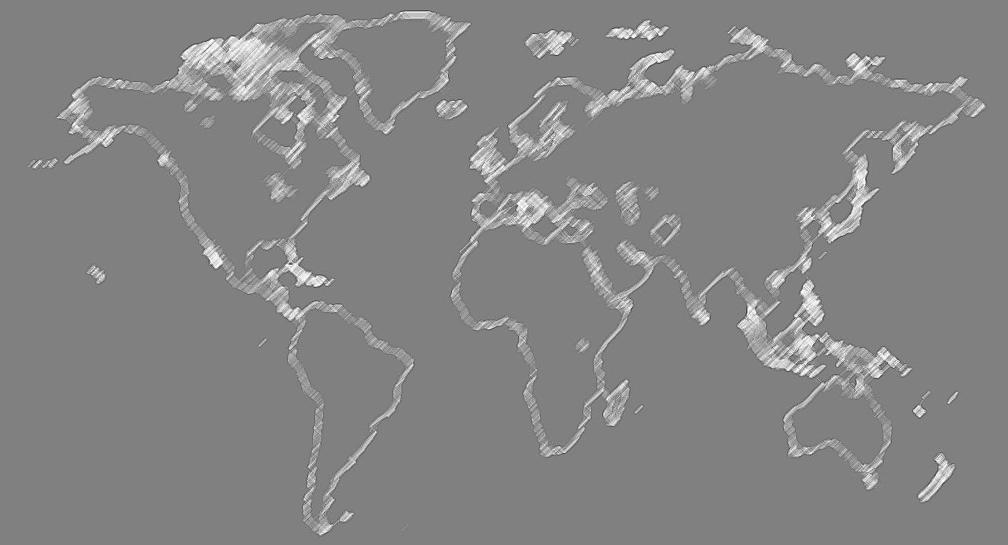
A Blending of Languages and Cultures
Greater than 32M speakers
Russian
English
German
Ukrainian
French
French
Polish
Wu
Mandarin
English
Spanish
Gujarati
Italian
Persian
Maithili
Cantonese
Japanese
Portuguese
Turkish
Sindhi
Korean
Hindi
Arabic
Min
Tamazight
Vietnamese
Spanish
Punjabi
Kannada
Bengali
Javanese
Marathi
Marathi
Telugu
Tamil
Malayalam
Portuguese
English
Source: http://en.wikipedia.org/wiki/Most_spoken_languages

Slide 23
A Blending of Languages and Cultures
Arabic | ‏تعاون (club up, collaborate, communion, concur, conspire, cooperate, cooperation, cope, get together, joining, participate, pull together, team up, unite), ‏إشتراك (implication, participation, partnership, subscription).
Japanese Katakana | がっさく (joint work), きょうどう (association, co-action, conduct, cooperation, guidance, instruction, joint, lead, sutra library, teaching), きょうりょく (cooperation, powerful, strong), きょうちょうしゅぎ, きょうちょ (co-authorship).
Romanian | conlucrare (concurrence, co-operation), colaborare (concurrence, contribution, co-operation, team work), ajutor (abettor, accommodation, accomplice, aid, assistance, assistant, auxiliary, backer, backing, contribution, co-operation, help, helper, helpfulness, helping).

Slide 24
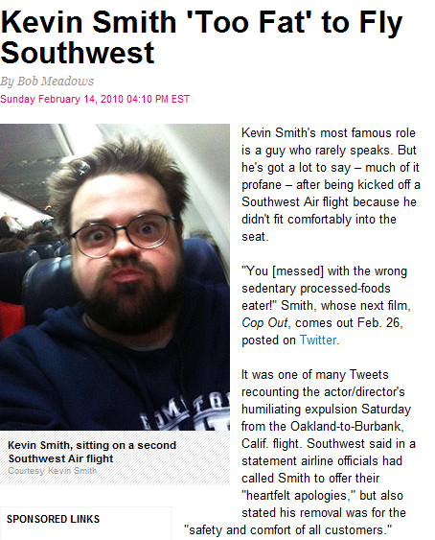

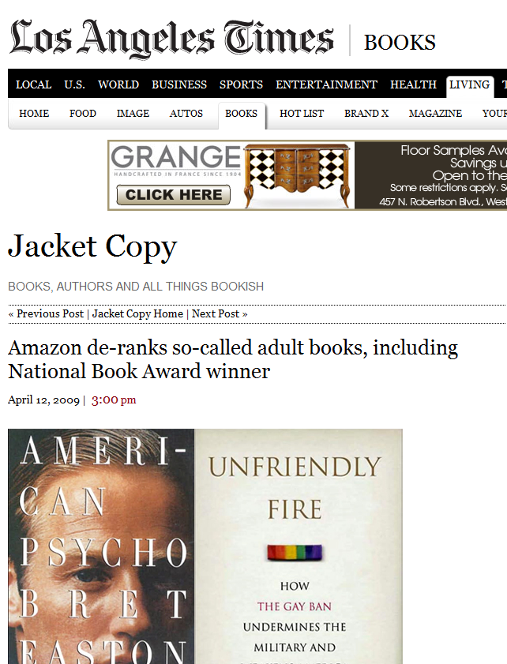

Go Transparent
Citizen
Regulators
http://www.people.com/people/article/0,,20344142,00.html

Slide 25
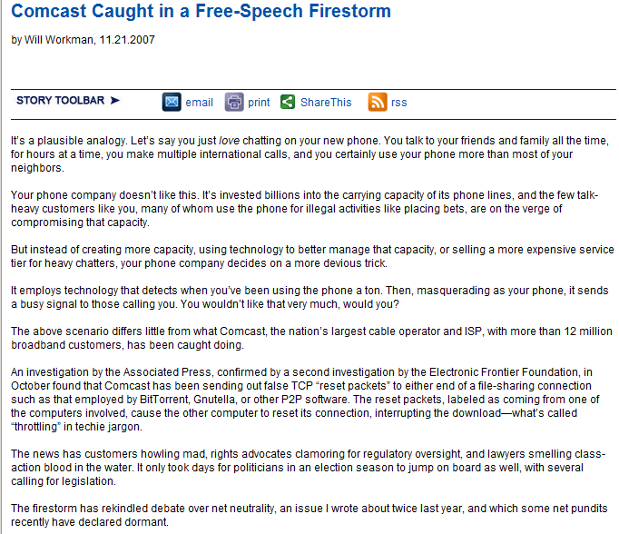




Slide 26


Go Consumer
Drive old conversations into new channels
Go the where the customers are

Slide 27


Go Knowledge
From Output to Outcomes

Slide 28

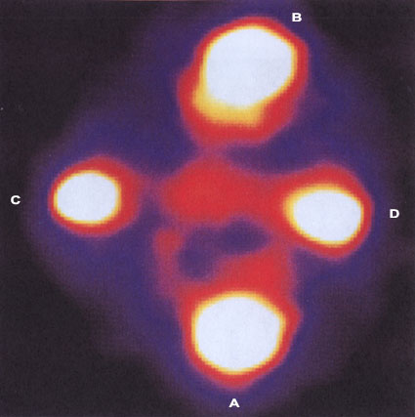

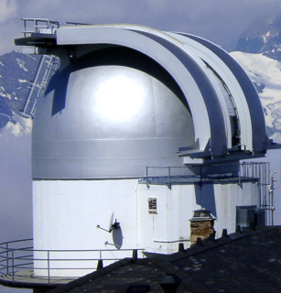

Go with an Open Mind

Slide 29





















Thank You
Notes:
29

