Slide 1
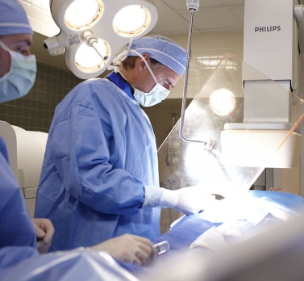
“Healthcare is a people business.
To be sustainable, health organizations
must communicate and connect with their
customers through innovative approaches and fresh perspectives...”
Top 7 Trends in Health Care, PricewaterhouseCoopers’ Health Research Institute, 2007
Philips Healthcare
Heather Cunningham, Localization PM
Localization Chair for Philips Healthcare Doc-Loc Council
May 20, 2010 – Introduction for Breaking out of the Silo
Notes:
Script
We start with a quote, not from Philips, but from Price Waterhouse Coopers, the largest professional services company worldwide. It reads, “Healthcare is a people business.”
Now to us, that may seem obvious, but when you look at the challenges in healthcare today, it is apparent that we sometimes forget that healthcare is about a patient, who needs help, and a care provider who is trying to deliver the best care.
At Philips, this insight drives everything we do.

Slide 2
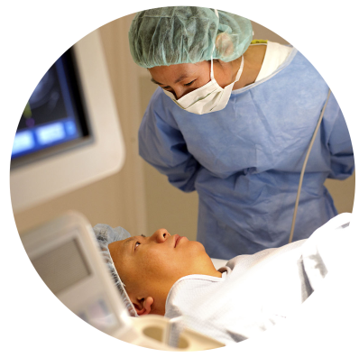
Philips Simply focused on health and well-being
Projected sales split
A global company of leading businesses creating value with meaningful innovations that improve peoples’ health and well-being
37%
34%
Healthcare
Lighting
Consumer Lifestyle
29%
1 million
Customers purchase
our products every day
A leader in healthcare for over 100 years
55,000
Technology patents
€23.2
Billion in sales
2
Notes:
Script
So, to start, it’s important to realize that Philips is unique in its focus on health and well-being.
As a company, we are fundamentally different than our competitors in our exclusive focus on health and well-being.
The way we’re structured reflects this. Healthcare is a core part of our business. It’s not buried in industrial infrastructure or some other place deep in the company. It’s one of our three core businesses.
And since Philips has a strong consumer business, we interact with millions of customers and millions of consumers every day who watch Philips televisions, use our toothbrushes and have switched to our energy efficient lighting.
In this process, we learn how people interact with technology. How lighting and environment can affect people’s health and well-being. And we pull this all together to deliver meaningful innovation and improve people’s lives.
Philips has been a leader in healthcare for over 100 years ago.
And we are a technology leader in driving major advances in technology with over 50,000 patents in our name.
Philips is large and growing, both organically and via acquisitions, with sales of 23.2 billion Euro in 2009, which translates to roughly $31.7 billion.
Supporting Data
$31.7 billion in sales

Slide 3
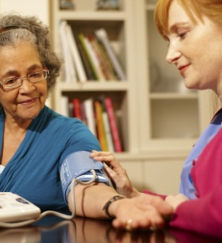
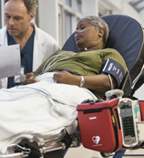
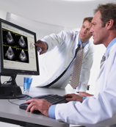
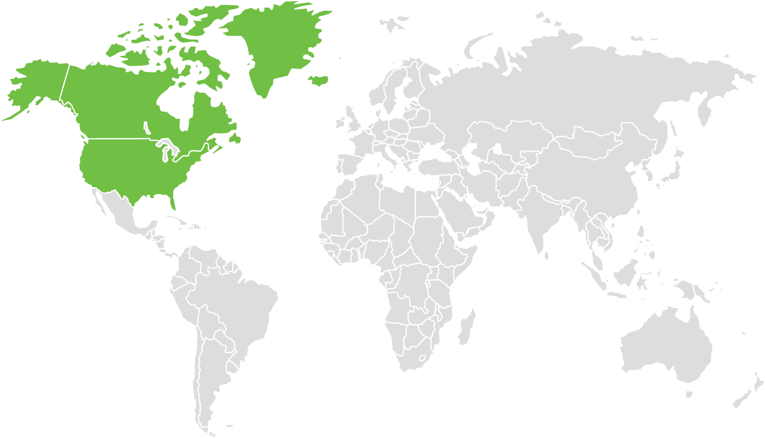
Depth and reach of Philips Healthcare What we do. Where we are.
Philips Healthcare
Businesses
Sales & services geographies
Imaging Systems
Home Healthcare Solutions
Clinical Care Systems
Healthcare Informatics
Services
North America
International
Emerging Markets
32%
14%
15%
13%
26%
48%
34%
18%
€7.8 Billion in sales in 2009
34,000+ People employed worldwide in 100 countries
9% of system sales invested in R&D In 2009
450+ Products and services offered in over 100 countries
Notes:
Supporting Data
$10.5 billion in sales

Slide 4
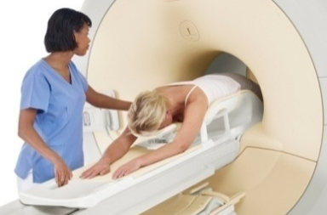
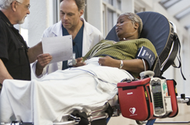
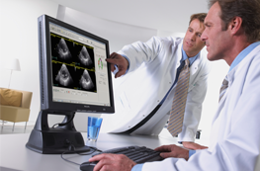
Key products and service of Philips Healthcare Providing comprehensive support
Philips Healthcare
Businesses
Businesses
Imaging Systems
Home Healthcare Solutions
Clinical Care Systems
Healthcare Informatics
Services
Cath Lab
X-Ray
CT
MR
SPECT
SPECT/CT
PET/CT
Sleep Disordered Breathing
Medical Alert Services
Home Cardiac Monitoring
Home Respiratory
Senior Living
Ultrasound
Cardiac Resuscitation
Ventilation
ECG Solutions
Children’s Medical Ventures
Medical Consumables & Supplies
Emergency Care Services
Anesthesia Informatics
Cardiology Informatics
Critical Care Informatics
Clinical Decision Support Systems
Maternal & Perinatal Monitoring Solutions
Patient Monitoring Systems
Radiology Informatics
Site Planning & Project Management
Ambient Experience
Education Services
Performance Services
Managed Services
Equipment Maintenance

Slide 5
We are a global healthcare leader Innovating. Driving the market.
Our foundation
Aggregating technologies
Expanding care settings
Global footprint
Interactive Medical Developments (2008)
Marconi (CT 2002)
Agilent (Patient Monitoring 2001)
ATL (Ultrasound 1998)
Lifeline (2006)
Raytel (2007)
Stentor (Radiology IT 2005)
Traxtal (2009)
TOMCAT (Cardiac IT 2008)
Healthwatch (2007)
CV/X-Ray
ADAC (Nuclear Medicine 2000)
MR
Agilent (Patient Monitoring 2001)
Goldway (2008)
Intermagnetics (MR 2006)
Medel (2008)
Philips Neusoft (2004)
InnerCool Therapies (Emergency Care 2009)
VISICU (Critical Care IT 2007)
XIMIS (Radiology IT 2007)
Alpha (2008)
Respironics (2008)
Meditronics (2008)
Witt (Cardiac IT 2006)
VMI-Sistemas Medico (2007)
EMERGIN (Cardiac IT 2007)
Dixtal Biomedica e Technologia (2008)
5
Notes:
Timeline of Philips acquisitions
1998: ATL Ultrasound (US$ 800M)
2000: ADAC Laboratories (US$ 426M)
Agilent Technologies (US$ 1,700M)
2001: Marconi Corporation (US$ 1,100M)
2002: Two USA dealer service businesses (US$ 3.6M)
Richardson Tubemaster (US$ 13.9M)
Dosimetry Business (US$ 1.1M)
Metzacom USA (US$ 1.6M)
2003: R.P. Kincheloe - USA Dealer, PMS (US$ 20.2M)
2004: Philips Neusoft Medical Systems (US$ 60M)
SLI Warehouse(US$ 3.8M)
2005: Kereos (ND)
Stentor (US$ 280M)
2006: Traxtal Technologies Inc (ND)2
WITT Biomedical (US$ 165M)
Intermagnetics (US$ 1,300M)
Lifeline (US$ 690M)
2007: XIMIS Inc (ND)
Health Watch (US$ 127M)
All Metro ERS (ND)
VMI-Sistemas Medico (ND)
Raytel (US$ 110M)
Emergin (ND)
Visicu (US$ 430M)
Respironics (US$ 5,040M)
2008: Tomcat (ND)
Shenzhen Goldway (ND)
Dixtal Biomédica e Technologia (ND)
2009: Traxtal (ND)
Our people share a passion for making an impact in healthcare.
We value clinical expertise, broad experience in healthcare and personal involvement in improving healthcare around the world.
It’s just one way that we are
people-focused.

Slide 6
Philips Healthcare DocLoc Council – May 2010
Steering Committee
Communication/Support
Chair
Service Documentation Team Lead
User Documentation Team Lead
Localization Team Lead
(DXR)
(DXR)
(DXR)
(PGP)
(CTO)
(US)
(US)
(US)
(QS)
(Q&R)
(Resp)
(Resp)
(Resp)
(CL Doc)
(Mktg)
(DECG)
(DECG)
(DECG)
(CRI)
(SC)
(PM-A)
(PM)
(IT)
(IS)
(PM)
(PM)
(PM)
(CL)
(CT)
(CT)
(CT)
(Service)
(NM)
(NM)
(NM)
(GCS)
(ECR)
(ECR)
(ECR)
(Web)
(EII-RIS)
(EII-RIS)
(BL-RIS)
Team
(MR)
(MR)
(MR)
(Marcom/Design)
(CIS)
(CIS)
(CIS)
(PII)
(PII)
(PII)
(EII-PACS)
(EII-PACS)
(EII)
(CC)
(CC)
(CC)
(iXR)
(iXR)
(iXR)
(StGuide)

