Slide 1
Semantic Technology for Business J. Brooke Aker CEO Expert System USA prepared for Gilbane San Francisco
Spring 2010

Slide 2
Why Use Semantic Technology
Customer Service & Support
Communication / PR / Reputation
Worker Productivity
Decision Support
Support Sales
What organizations want IT to provide
R&D
Source: AMR Research
Sourcing & Procurement
Governance & Compliance
Financial Processes
Other
Notes:
May I know your area of responsibility?
What is the biggest challenge you face currently?
What area would you like to know more about?

Slide 3
Why such a high ROI?
15 petabytes of new data each day
15 billion searches / month – 1/3 don’t result in clicks
2.3 hours per day spent in searching for information
BUT more data, properly analyzed, provides a clearer picture
$1
$400
Notes:
Will you look at the fact I’ve presented and decide if the analysis I’ve presented makes sense?

Slide 4
What does “Properly Analyzed” Mean
Business Intelligence 1.0
ERP
(Resources)
EPM
(Performance)
ERM
(Risk)
Biz. Applications Layer
Accounting &
Compliance
Operations
PR & IR
Planning &
Analysts
Innovation
and R&D
Executive
Management
Biz. Functions Layer
Dashboards &
Scorecards
Query &
Reporting
Information
Analysis
Information
Discovery
Biz. Process Layer
Data
Mart
Keyword
Indexing
SQL
XML
RSS
Blogs
Technology Layer
20% Data
Information Volume
80% Text

Slide 5
What does “Properly Analyzed” Mean
Business Intelligence 2.0
Advertising
Insight
(Placement)
Voice of the
Customer
(Blog Sentiment)
Situational
Awareness
(Intelligence)
Biz. Applications Layer
Accounting &
Compliance
Operations
PR & IR
Planning &
Analysts
Innovation
and R&D
Executive
Management
Biz. Functions Layer
Dashboards &
Scorecards
Query &
Reporting
Information
Analysis
Information
Discovery
Biz. Process Layer
Data
Mart
Keyword
Indexing
SQL
XML
RSS
Blogs
Semantics
Technology Layer
20% Data
Information Volume
80% Text

Slide 6
What does “Properly Analyzed” Mean
COGITO® : deep analysis
4 Approaches | Definition | Example
Morphological Analysis | understand word forms | dog, dogs, and dog-catcher are closely related
Grammatical Analysis | understand the parts of speech | "There are 40 rows in the table" uses rows as a noun, vs. "She rows 5 times a week" uses rows as a verb
Logical Analysis | understand how words relate to other words | "Jeffrey Skilling, represented by Attorney Daniel Petrocelli, is married to Rebecca Carter". Rebecca is married to Jeffrey not Daniel.
Semantic Analysis (disambiguation) | understand the context of key words | "I used beef broth for my soup stock" uses stock in the context of food, vs. "The company keeps lots of stock on hand" uses stock in the context of inventory.
Notes:
6

Slide 7
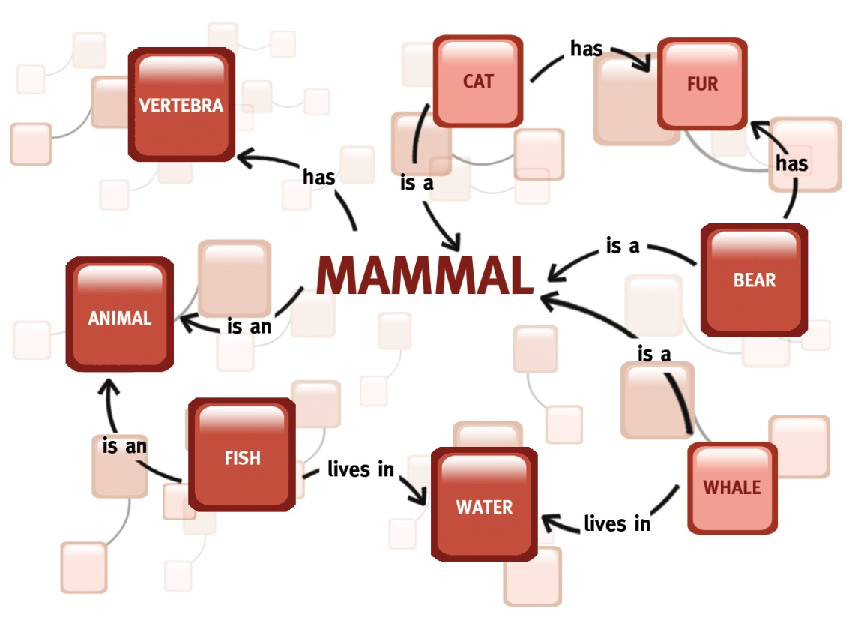
What is a Semantic Network?
The heart of semantic technology;
Quality of results derived from the complexity and richness of the network.
Includes all definitions of all words.
Include relationships among all words.
COGITO® English
Semantic Network:
- 350,000 words
- 2.8m relationships

Slide 8
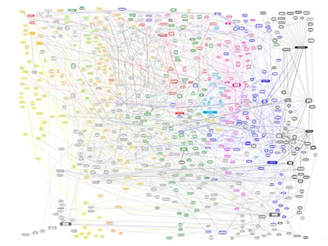
90% +
Precision
4 MB per Minute Speed
<10⁻⁶ Access Time
35 Entity Extraction
Types
600+ Categories
What distinguishes a Semantic Network?

