Slide 1
Open Source Content Management in the Enterprise
Aldo X. Bermudez
Senior Manager, Web Publishing

Slide 2
Open Source Content Management in the Enterprise
Agenda
Introduction
Background of Cisco WebEx
Our problems
The challenges
The game changer
Our business requirements
Why Open Source
Q&A

Slide 3
Who am I?
A few words about myself
16 years of Web Marketing
10+ years in CMS/TMS implementation
My areas of expertise are:
Web Globalization
Localization
Content Creation Strategy
Implementation of global systems
My specialty: Optimizing the business value of web sites and global web operations

Slide 4
Cisco & WebEx
Background of Cisco WebEx
Market leader in on-demand collaboration technologies
7 million users
35,000 customers
Subscription based services strategy has been key to success
Acquired by Cisco Systems Inc. in May 2007 for $3.2 billion
Worldwide leader in networking
63,000+ employees (Q4 2009)
Revenue of $36.1 billion for (Q4 2009)

Slide 5
Enterprise Web Content Management
Does your job feel like this often?

Slide 6
Do your web operations look like this?
Too many people with too many opinions?

Slide 7
Where we came from…
Problems in our organization
Decentralized approach to web operations
Silos between regions
Corporate branding and messaging not aligned
Resources not well aligned to business priorities
Infrastructure not set globally
Missing localization strategy

Slide 8
The game changing solution
Setting our business requirements

Slide 9
Global Centralized infrastructure
Stop adding silos, find a tool that meets your needs!

Slide 10
Faster Time-to-Market
Don’t let anyone slow you down

Slide 11
Align to Corporate branding and messaging
We are one company, aren’t we?

Slide 12
Reduction of Total Cost of Ownership
Saving money never got anyone fired…

Slide 13
Our business requirements
Must-have vs. nice-to-have

Slide 14
Our business requirements
Multi-Domain and Multi-Tier infrastructures

Slide 15
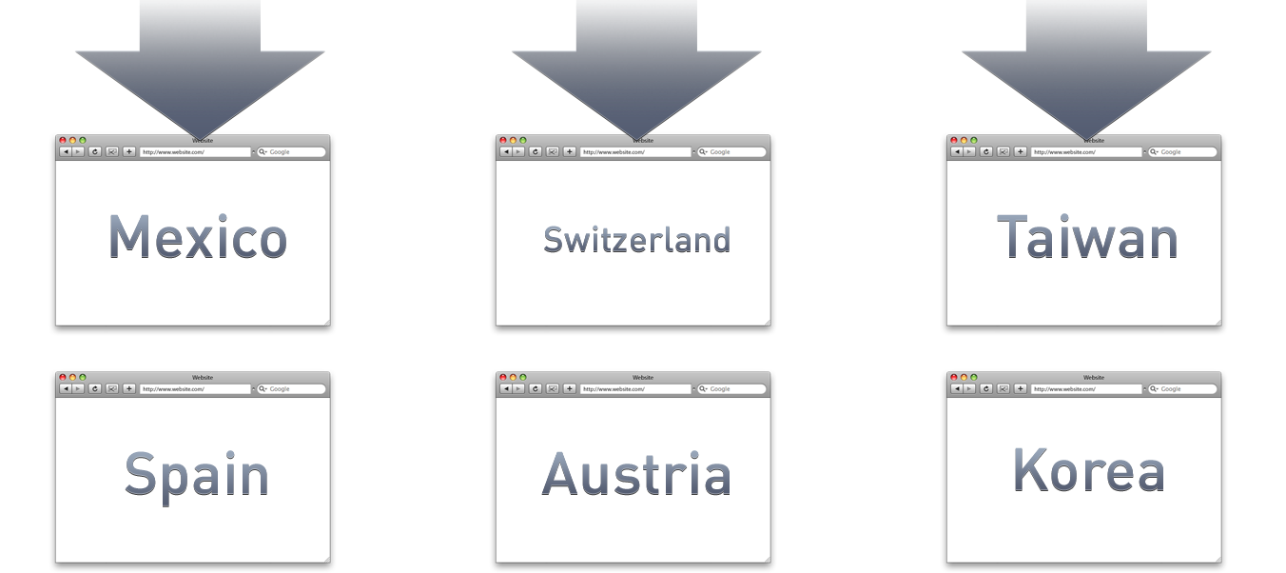
Our business requirements
Multi-Domain and Multi-Tier infrastructures
Tier 1
Tier 2

Slide 16
Our business requirements
A Web Development Framework

Slide 17
Our business requirements
360° Translation Workflows

Slide 18
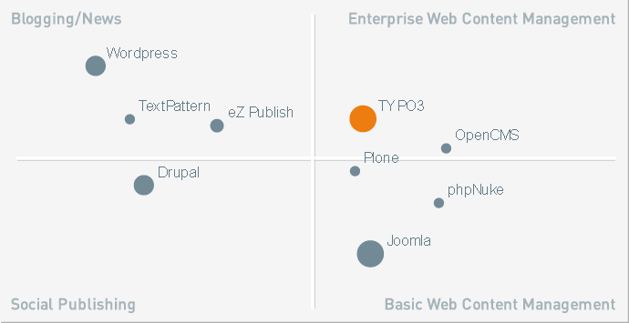
Our Solution
Choosing the right Open Source Enterprise CMS

Slide 19
Our choice: TYPO3
Mature, Scalable, Community-driven Enterprise Web CMS
Advanced Multi-language features
Workspaces (Accurate publishing preview)
Multi-Domain and Multi-Tier infrastructures
360° Translation Workflows
Multi-Variant Testing & Tracking
Fully flexible Templating Engine
Flash-driven Content
Static & Dynamic Publishing

Slide 20
The importance of adoption
The TYPO3 ecophere
500,000+ websites
100,000 developers
2,000 TYPO3 agencies
4,000+ modules
100% community Open Source

Slide 21
Why Open Source?
What are the driving factors?

Slide 22
Total Cost of Ownership
TYPO3 CMS vs. Proprietary CMS
TCO: $442,000 US
TCO: $1,398,000 US
TCO over a 1 year period incl. initial launch (15 global sites with 9 languages)

Slide 23
Global community
Inspiring people to share (Community Open Source)

Slide 24
The hungry vendors problem
When will your CMS be bought-out/discontinued?

Slide 25
is becoming the dominating force on the
WEB

Slide 26
Why TYPO3 is a game changer for Cisco WebEx
Our biggest wins with TYPO3:
Open Source – no license costs = more budget for customization, integration & support
TYPO3 is a web development framework = Unlimited extendibility and flexibility
Extremely powerful globalization features
Faster time-to-market
Independence – free choice of support vendors
Presentation_ID
Presentation_ID
© 2009 Cisco Systems, Inc. All rights reserved.
© 2009 Cisco Systems, Inc. All rights reserved.

Slide 27
Q and A
Want to know more?
Come to the TYPO3 Product Lab
from1pm - 2pm and win a
iPAD 3G*
*Winner will be drawn from all
submissions of business
cards at the end of the demo
27
27

Slide 28
Open Source Content Management in the Enterprise
Thank you!
Contact information:
Aldo X. Bermudez
Senior Manager, Web Publishing
Collaboration Software Group
albermud@cisco.com
Images: Cisco Systems, Fotolia, iStockPhoto, Flickr
28
28

